Slide 1
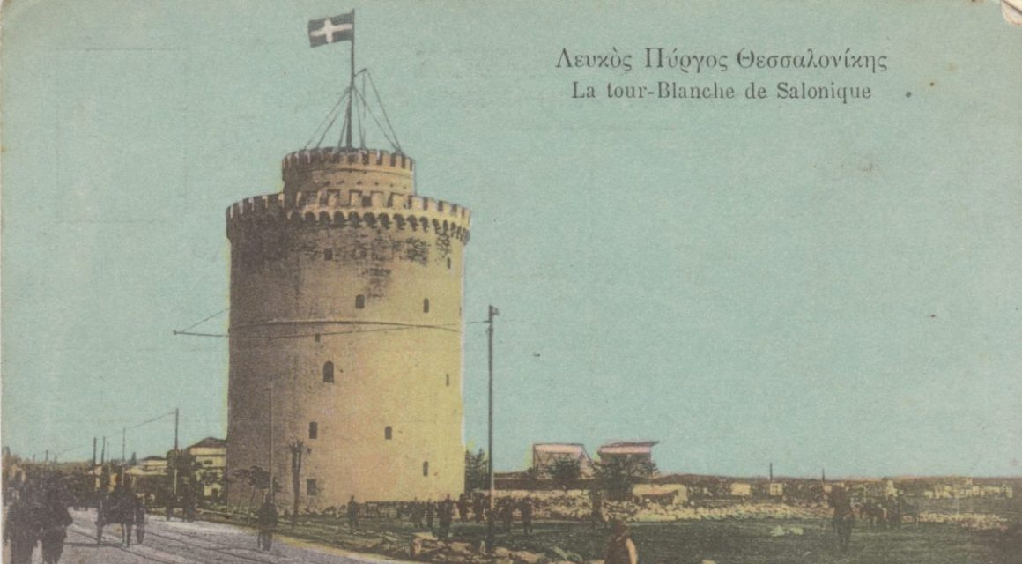
Salonika
1915-1918
Notes:
About these slides
These materials have been produced by the Salonika Campaign Society.
Teachers and schools are free to use and adapt this resource to meet the needs of their pupils.
A Brief Summary of the Salonika Campaign
The Salonika Campaign was part of the First World War and took place in the Balkans between 1915 and 1918. It is also known as the Macedonian Front. The campaign began in October 1915, when Allied forces landed at the port city of Salonika, in northern Greece. These forces were mainly made up of soldiers from Britain and France, with later support from other Allied nations. Their main goal was to help Serbia, which was being attacked by several enemy countries.
At the time, Serbia was under severe pressure from the Central Powers, including Germany, Austria-Hungary, and Bulgaria. Serbia had already been fighting since 1914 and was exhausted by the time Bulgaria joined the war against it in 1915. The Allies hoped that by sending troops to Salonika they could support Serbia and stop the enemy advance in the Balkans. However, poor planning, difficult transport, and slow decision-making meant that the Allied forces arrived too late to make a difference.
By the time the Allies were ready to move north from Salonika, Serbia had already been defeated and occupied. The Serbian army was forced to retreat through harsh mountain terrain during the winter, suffering heavy losses. This failure raised questions about whether the Allies should withdraw their troops from Greece altogether or remain in the region despite the setback.
Instead of leaving, the Allies decided to stay and establish a new front based around Salonika. They built defensive positions and turned the city into a major military base. This decision marked the start of a long and complex campaign in the Balkans, which would continue until the final year of the war and involve fighting across difficult and unfamiliar terrain.
For much of the campaign, fighting was limited and progress was slow. Soldiers faced difficult conditions, including harsh weather, mountainous terrain, and serious diseases such as malaria. Because there were few major battles at first, some people in Britain and France dismissed the campaign as unimportant and even called it a “sideshow” to the war on the Western Front.
In 1918, the situation changed dramatically. Allied forces launched a major attack that broke through enemy lines, leading to the defeat of Bulgaria and the collapse of the Central Powers in the Balkans. This success helped speed up the end of the war. Although often overlooked, the Salonika Campaign played an important role in weakening Germany and its allies during the final months of the First World War

Slide 2
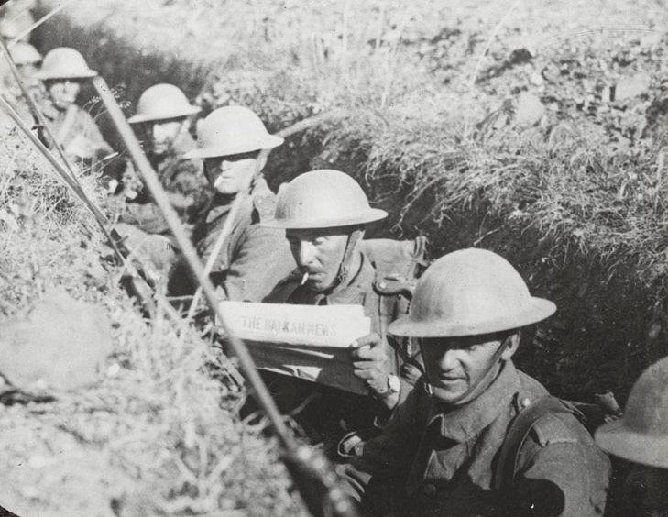
Salonika Campaign 1915-1918
What is a ‘Campaign’?
The Salonika Campaign was part of the First World War and was fought from 1915 to 1918.
In the Salonika Campaign, British soldiers fought alongside allies in Salonika, far from the better-known battlefields in France.
Notes:
Teacher notes:
“What is a campaign?” A military campaign is (i) large-scale (ii) long-duration (iii) significant military plan. It incorporates of interrelated military operations or battles. It is a distinct part of a larger conflict or war. The word campaign comes from the French campagne (meaning “open country” or “field”), and the French are supposed to have taken the word from the Italian campagna. The Italian word comes from the Late Latin word for “level country” (campania), which descended from the earlier Latin term for the level country in the plain of Campania, a place of annual wartime operations by the armies of the Roman Republic.
Emphasise that WWI was global, not just fought in France and Belgium. This campaign is sometimes called a “forgotten front,” which helps explain why pupils may not have heard of it before.

Slide 3
Part 1
Salonika?
Notes:
Teacher notes:
There are three sections to this presentation:
Part 1 – explores where Salonika is and why Britain sent troops there.
Part 2 – explores aspects of British involvement after the defence of Salonika following the defeat at Kosturino.
Part 3- explores the end of the Campaign and its legacy.

Slide 4
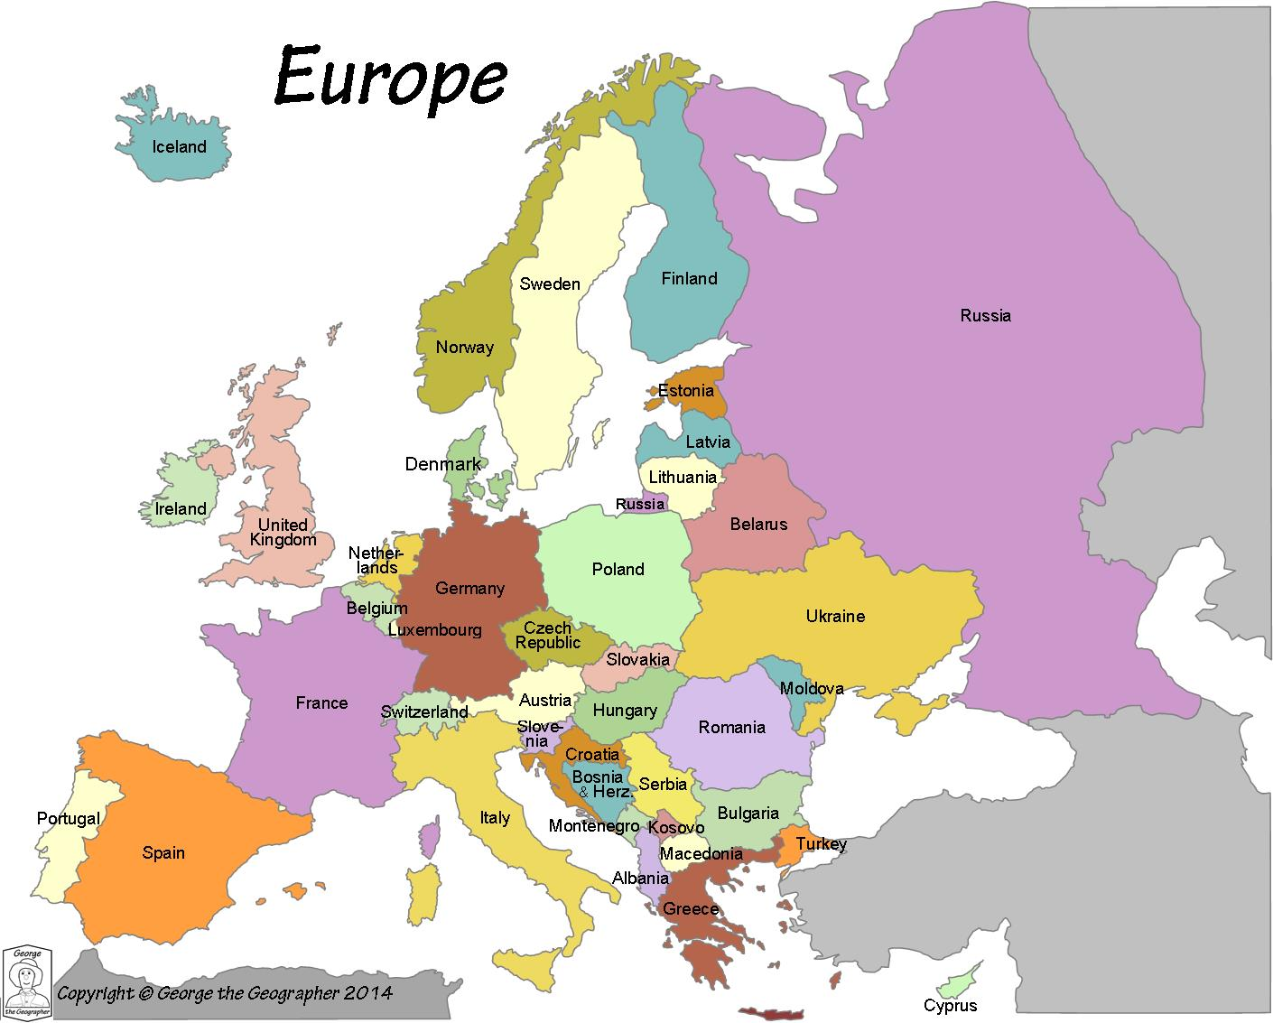
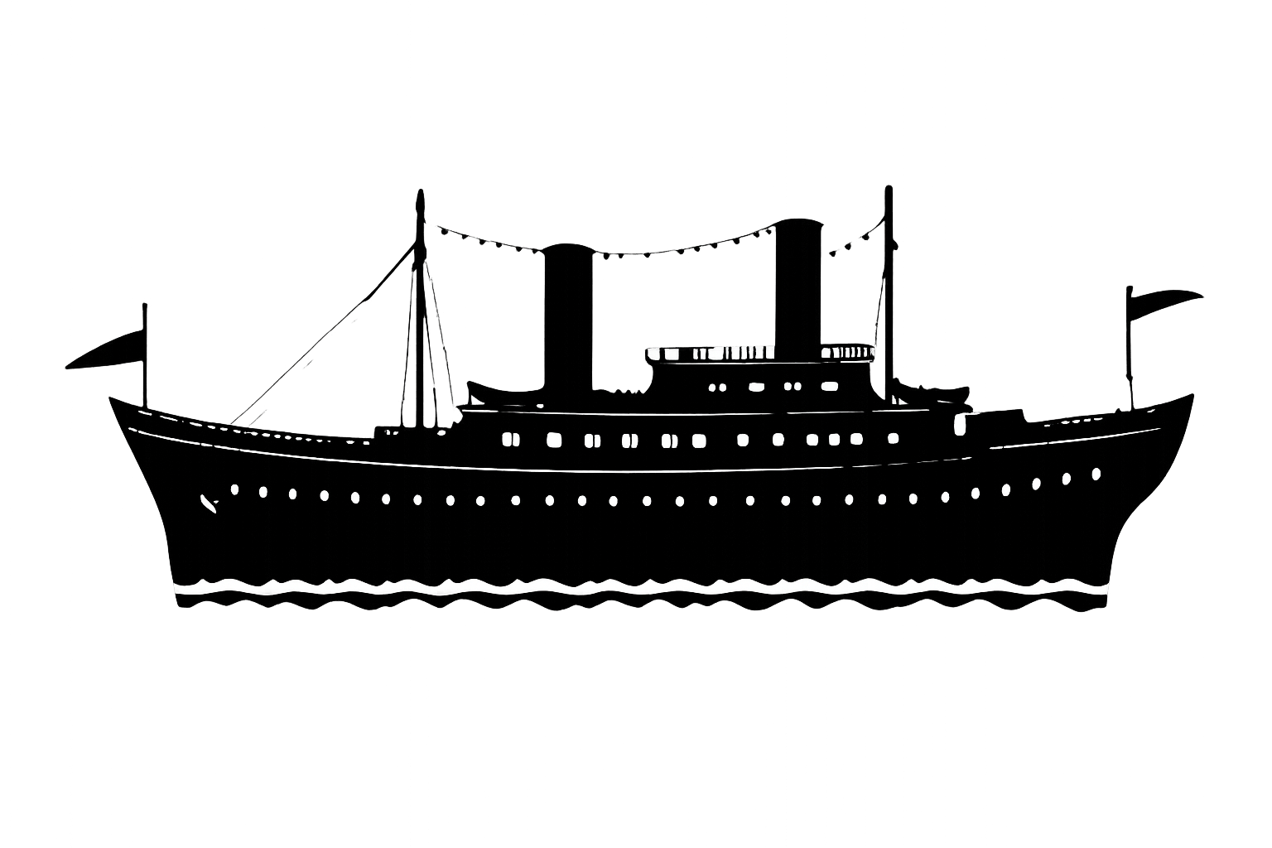
How will troops get there?
How will supplies get there?
What will happen if the enemy has submarines?
How can men go home on leave?.
6,300 Kilometres / 3,915 Miles
Notes:
Teacher notes:
Use the map to show simplified view of modern Europe.
Ask the pupils to ‘pin the tail on the donkey’ – where is Salonika?
- First fly-in marker shows (approximately) the location of Salonika
- Second fly-in marker shows (approximately) the location of Gallipoli
Discuss problems of location. Ask pupils to imagine they are planning the campaign:
How will troops get there?
- How will supplies get there?
- What will happen if the enemy has submarines?
How can men go home on leave?.
The distance by boat from Southampton to modern Thessaloniki is (6,300 Kilometres / 3,915 Miles)

Slide 5
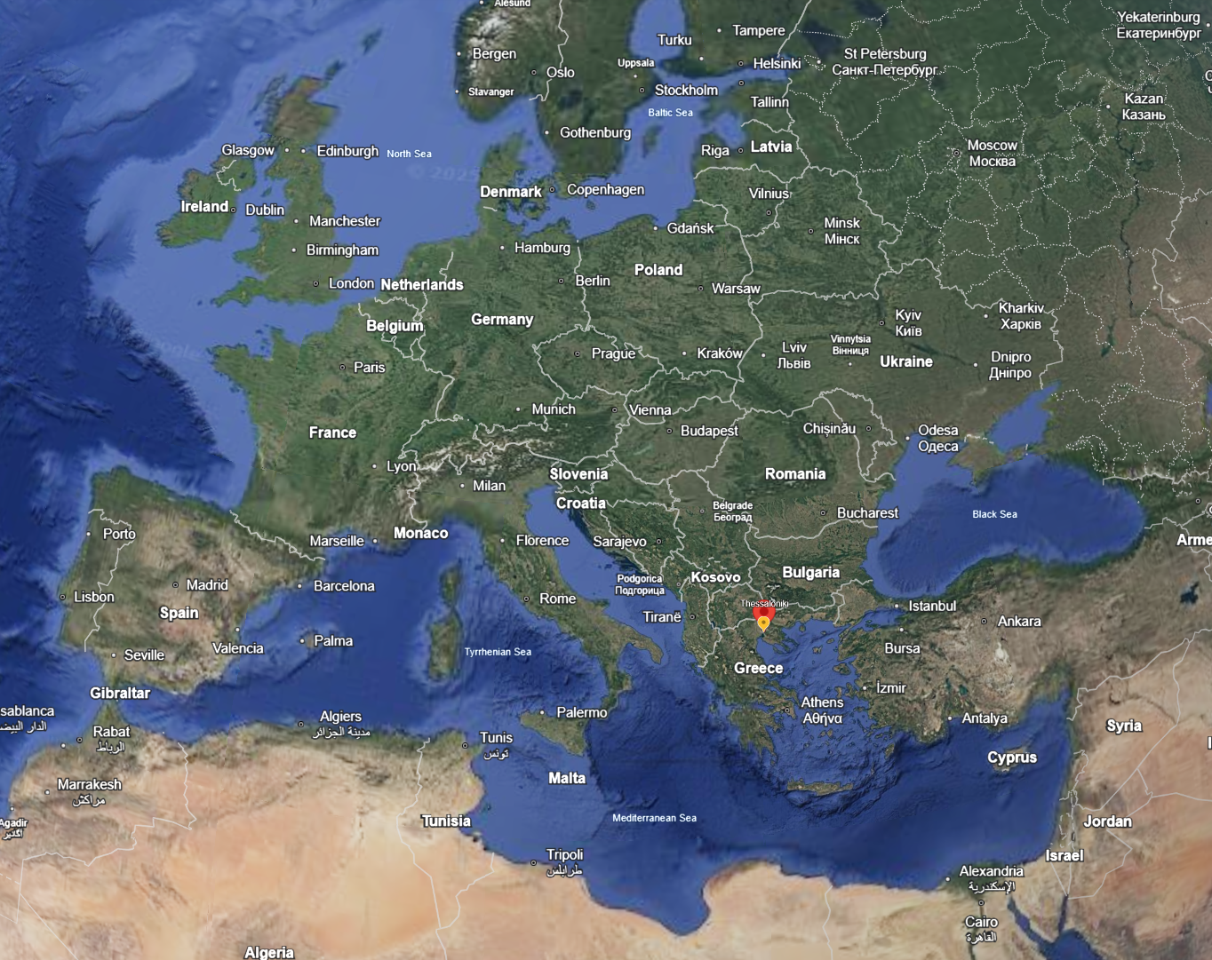
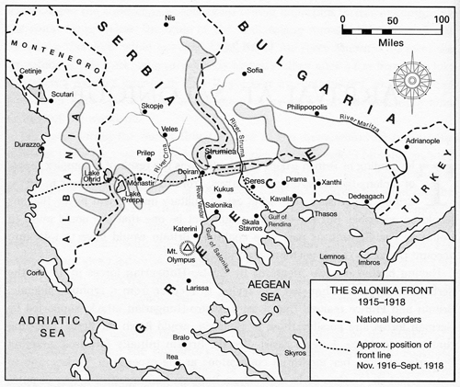
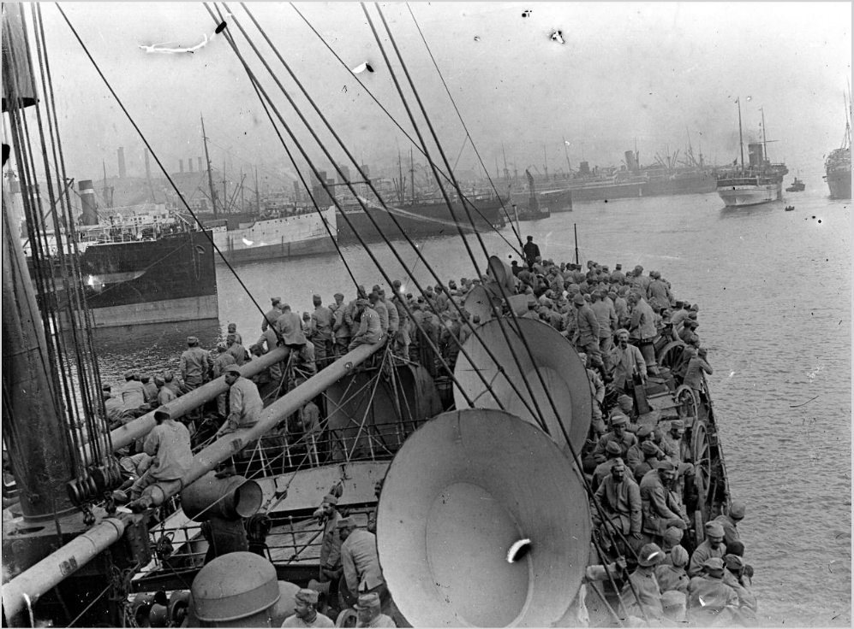

Salonika = Thessaloniki
Google Earth
Salonika, now called Thessaloniki, is a port city in northern Greece.
Its harbour made it an important place for Allied ships to land troops and supplies
This area of Greece is called Macedonia.
Notes:
Teacher notes:
Use a map to show Greece, the Balkans, and the Mediterranean. Highlight that ports were crucial in WWI for moving men and materials.
The map in the centre is enlarged in the next slide.
The image of the globe links to Google Earth – enabling an animated view of Salonika’s location.

Slide 6
Notes:
Teacher notes:
Use a map to show Greece, the Balkans, and the Mediterranean. Highlight that ports were crucial in WWI for moving men and materials.
NB – this area of Greece is known as Macedonian. It gets its name from the ancient Greek kingdom of Macedon and is the birthplace of Alexander the Great.

Slide 7
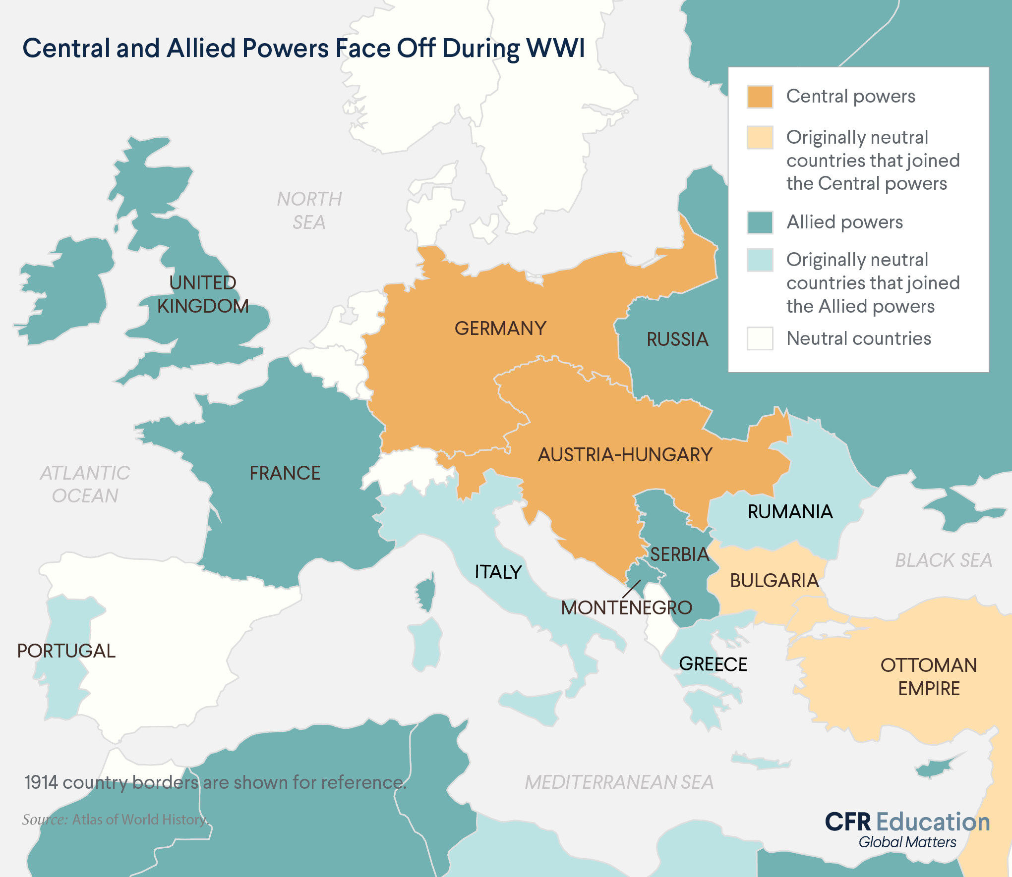
The Great War/World War One
1914 – The war begins
World War 1 starts after a crisis in Europe
Two main sides form:
The Allies
Britain, France, Russia - later joined by others, like Greece and the USA
The Central Powers
Germany, Austria-Hungary, Ottoman Empire (Turkey) - later joined by Bulgaria.
Notes:
Teacher notes:
Setting the context for Allied involvement in Salonika

Slide 8
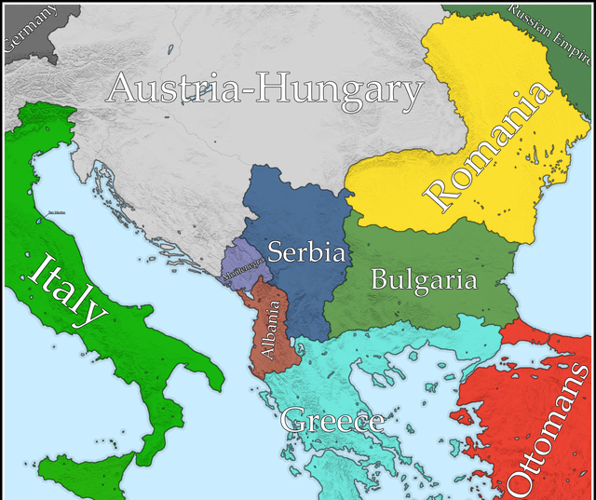
Why were British troops in Salonika? (1)
Serbia is a friend of Britain and France
1915
Bulgaria joins the Central Powers
Serbia is now almost surrounded
In October, Bulgaria, Germany and Austria-Hungary attack Serbia.
Notes:
Teacher notes:
Serbia was an ally of Britain and France
Bulgaria joins the Central Powers
In October, Bulgaria, Germany and Austria-Hungary attack Serbia.

Slide 9
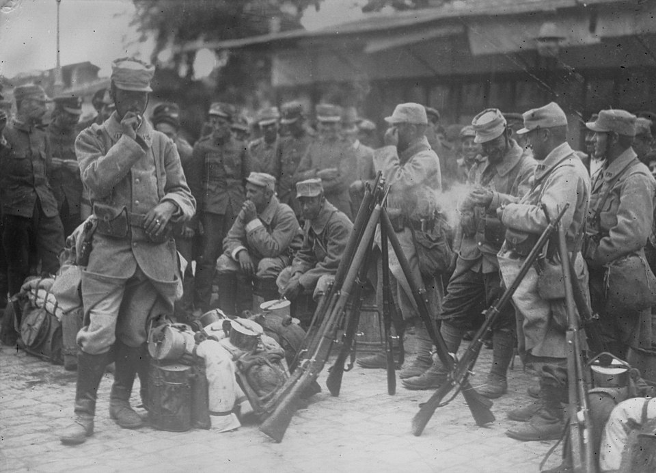
Why were British troops in Salonika? (2)
So, Britain and France send troops to the port of Salonika to help Serbia.
Notes:
Teacher notes:
1) To help Serbia against the Central Powers
In 1915, Serbia was attacked by Germany, Austria-Hungary, and Bulgaria.
Britain and France wanted to support Serbia, their ally, so they sent troops to the nearby port of Salonika as a base for operations in the Balkans.
2) Because Bulgaria joined the Central Powers
When Bulgaria entered the war on the side of Germany and Austria-Hungary in 1915, Serbia was almost surrounded.
The Allies hoped to:
Reinforce Serbia
Open a new front against Bulgaria and the Central Powers
Prevent the region from falling completely under enemy control
3) Greece’s complicated position
Greece was officially neutral at first, and its king was pro-German, while its prime minister was pro-Allied.
Despite this political tension, the Allies landed troops in Salonika anyway, partly to influence Greece to join them (which it eventually did in 1917).
In short, British and French troops were in Salonika to support Serbia, counter Bulgaria, and open a new front, which eventually played a key role in ending the war in southeastern Europe.

Slide 10
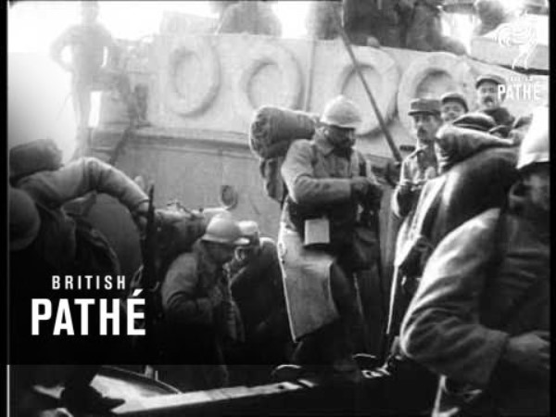
French troops arrive in Salonika, 1915
Notes:
Discuss the appearance of the French Soldiers (clean, new winter coats, backpacks, equipment).
A contrast to the British 10th Division that arrived exhausted from Gallipoli and without winter clothing and equipment.

Slide 11
Allied Forces Arrive (October 1915)
British and French troops land at Salonika in October 1915
But it is “too little, too late”
Overwhelmed by the Central Powers' forces, the Serbian army & many Serb civilians decide to retreat to the coast
They hope to be rescued & taken to the island of Corfu.
Notes:
Teacher notes:
Stress the frustration of arriving too late. This helps pupils understand why some people later criticised the campaign.
The Serbian retreat is known as “The Great Retreat” and is an important memory for Serbians to this day.
Image source and stats: https://en.wikipedia.org/wiki/Great_Retreat_(Serbia)

Slide 12
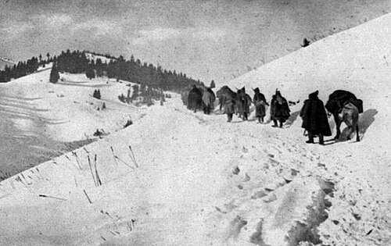
The Great Retreat 1915-1916
To get to Corfu, the Serbians have to cross mountains
  in freezing winter conditions
  while being attacked
  with little food, clothing or medicine.
Over 400,000 people set out on the journey
>235,000 soldiers and civilians die on the march.
Notes:
Teacher notes:
Stress the frustration of arriving too late. This helps pupils understand why some people later criticised the campaign.
The Serbian retreat is known as “The Great Retreat” and is an important memory for Serbians to this day.
Image source and stats: https://en.wikipedia.org/wiki/Great_Retreat_(Serbia)

Slide 13
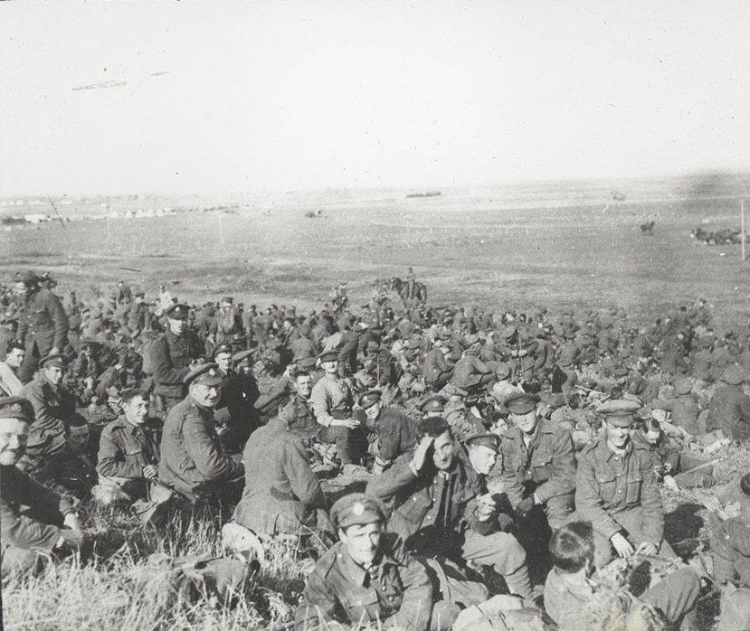
British Forces Arrive
The British 10th (Irish) Division, begin landing at Salonika on 5 October 1915
The soldiers are exhausted after fighting at Gallipoli
They set up defences in the Belashitza Mountains
They are not equipped for a cold winter.
Notes:
Teacher notes:
- 10th (Irish) Division began leaving Lemnos for Salonika on 5 October 1915 as the Austrians and Germans were about to launch their attack on Serbia.
The Irish assembled at camps north of Salonika from where they advanced piecemeal over the next few weeks towards the Belashitza Mountains to assist the French, already deployed there as well as further up the Vardar valley.
Unfortunately, the troops had not been equipped for a winter campaign in difficult mountain terrain.
By the end of November, more than 1,600 men had been evacuated from the division, many suffering from frostbite.
Compare and contrast the image of these soldiers with that of the French soldiers in the Pathe film.

Slide 14
‘Very bad night – no shelter from the cold and wet. I had a rotten passage round the line, falling and stumbling about in snow drifts up to my shoulders in some places.
The snow kept on falling yesterday evening and part of the night, and then changed to a most intense frost.
This morning everything is frozen hard and every track is too slippery to walk on…
Our overcoats are frozen hard, and when some of the men tried to beat theirs to make them pliable to lie down in they split like matchwood.
The men can hardly hold their rifles as their hands freeze to the cold metal.
Everyone is falling and tumbling about in the most ludicrous way…
We had an enormous sick parade this morning nearly 150 men reporting. There are many bad cases of frost bite in hands and feet.’
Diary of Captain Noel Drury
6th Battalion The Royal Dublin Fusiliers
27-28 November 1915
Notes:
Teacher notes:
The 10th Division eventually went into the line in the mountains around Kosturino in November as the Allies attempted to block the Bulgarian advance. Unfortunately, the troops had not been equipped for a winter campaign in difficult mountain terrain. By the end of November, more than 1,600 men had been evacuated from the division, many suffering from frostbite.

Slide 15
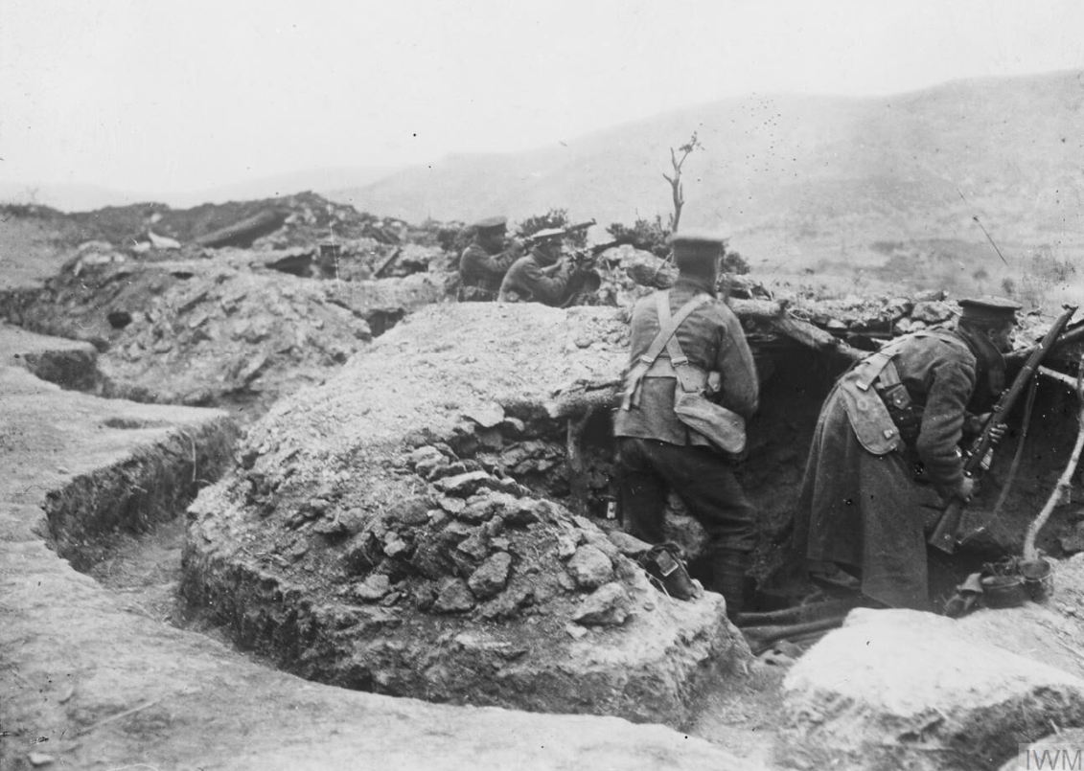
The Battle of Kosturino – December 1915
December 1915
Bulgarians attack the British and French at Kosturino over several days
The Allies are forced to retreat to Salonika
Luckily, the Bulgarians do not follow them.
Notes:
Teacher notes:
- An account of the Battle of Kosturino can be found here: https://www.royal-irish.com/events/bulgarians-attack-10th-irish-division-the-Balkans
“Battle of Kosturino:
The left of the Irish line, called Dollymount, was held by the 30th Brigade, while the right, called Bray Head, was held by the 31st Brigade. The 29th Brigade was in reserve. However, on 29 November the 5th Connaught Rangers and 10th
Hampshire Regiment of the 29th Brigade were ordered to relieve the 7th Royal Dublin Fusiliers and the 6th Royal Munster Fusiliers of the 30th Brigade to give them a spell of warmth. The relief was meant to be for 48 hours or 72 hours at the most. But then word came that on 11 December the division was to withdraw to Salonika, and the Rangers and Hampshires stayed in the front line. To facilitate the withdrawal non-essential stores were ordered to be sent to the rear. Even though the weather remained bitterly cold the order included the extra blankets and leather jerkins with which the men had been issued because of the conditions. But the planned withdrawal never eventuated.
Early on 7 December the Bulgarians in overwhelming numbers rushed and seized Rocky Peak. Then throughout the morning they poured a withering fire into the Irish trenches before mounting an attack on Dollymount pushing the defenders off that section of the ridge. By early afternoon the survivors were forced back to Crête Simonet and Crête Rivet, names which the French had given the two knolls to the south of the Kosturino Ridge. Some retreated further south as far as the reserve area at Tatarli and divisional headquarters at Dedeli. The forward line having been breached the 31st Brigade also withdrew to the new line. Fortunately, the Bulgarians did not follow up their attack with vigour so that the Irish were able to hold their new position for the next two days, enabling the French to withdraw to the Greek side of the border at Doiran and then the Irish to follow. Under orders from the Germans, who were still hoping that Greece would join their side, the Bulgarians halted at the border. By 20 December the British and French troops had returned to Salonika. Source: https://www.academia.edu/42826167/The_Battle_of_Kosturino_the_Irish_Australian_connection

Slide 16
You are in charge – what do you do next?
You have been defeated by the Bulgarians at the Battle of Kosturino
You have retreated to the port of Salonika
Will the Bulgarians continue to attack?
What are you going to do?
  Stay and fight the Bulgarians?
  Leave Salonika?
  What about the Serbians?
  Can they be helped?
  Will your forces, supplies and energy be better deployed in France?
???
Notes:
Teacher notes:
- Ask the pupils to make what is both a political and military decision?
What will you do?
Stay and fight the Bulgarians?
Leave Salonika?
What about the Serbians?
Can they be helped?
Will your forces, supplies and energy be better deployed on the Western Front?

Slide 17
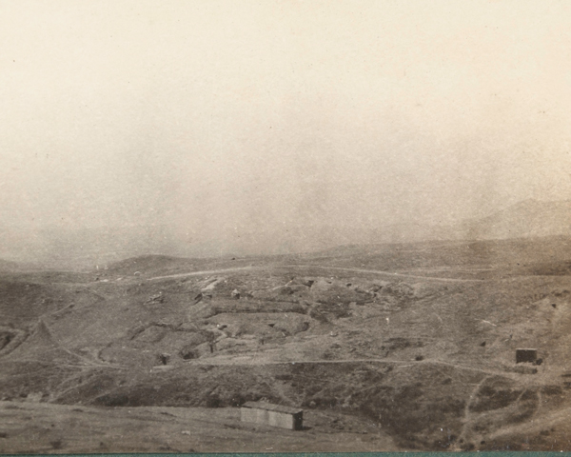
The Birdcage
The defeat at Kosturino means the British have to decide whether to stay in Greece or leave
Staying could mean more losses but leaving feels like giving up on their allies.
Worried that the Bulgarians will attack, the Allies retreat to Salonika to defend the city
A huge barbed-wire fence is built around Salonika
The troops call it ‘The Birdcage’.
Notes:
Teacher notes:
Image source; https://www.nam.ac.uk/explore/salonika-campaign
This loss meant they could not keep their positions in the Balkans safely.
The British had to decide whether to keep trying to fight there or retreat to save their soldiers.
It was a tough choice because staying could mean more losses, but leaving felt like giving up on their allies.

Slide 18
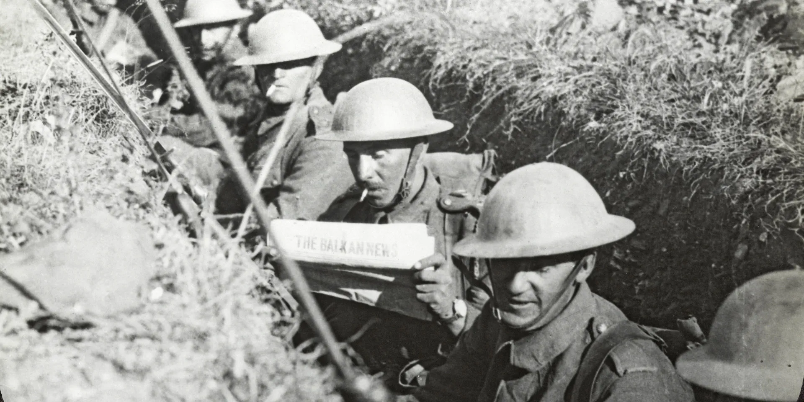
What is a ‘Front’ or ‘Frontline’?
In a military context, a "front" is:
The line of contact between two opposing forces
An active boundary where opposing armed forces engage in direct combat
A geographical area where armies are engaged in conflict
It marks the limit of secured territory
Where most of the fighting takes place
It is the zone of highest risk.
Notes:
Teacher notes:
What is a ‘Front’ or ‘Frontline’? “What is a Front?” - In a military context, a "front" refers to the line of contact between two opposing forces or a geographical area where armies are engaged in conflict
The Salonika Front was a long way from the most famous front – the Western Front in France.
A military frontline is the foremost, most advanced tactical combat position where opposing armed forces directly engage in conflict, representing the active boundary between warring sides. It contrasts with the rear, serving as the primary area of battle, troop concentration, and high-risk operations.
Key Aspects of Military Frontlines:
Definition: The line of contact, often called the "front," where enemy forces face each other, typically referring to land-based, direct-combat positions.
Structure: It is formed by the most advanced, ready-to-fight units. In contemporary conflict, this often involves complex, 1,200 km+ stretches with fortified positions, trench warfare, drone surveillance, and artillery, as seen in the 2026 Ukrainian defensive operations.
Components: Frontline soldiers, often in roles like infantry, armored cavalry, and artillery, operate in these high-risk areas.
Context: While historically representing a fixed line, modern frontlines can be fluid or, in static conflicts, characterized by entrenched, long-term engagements.
Usage Beyond Military: The term is sometimes used metaphorically for high-stakes, direct-action roles in other fields, such as in healthcare or emergencies.

Slide 19
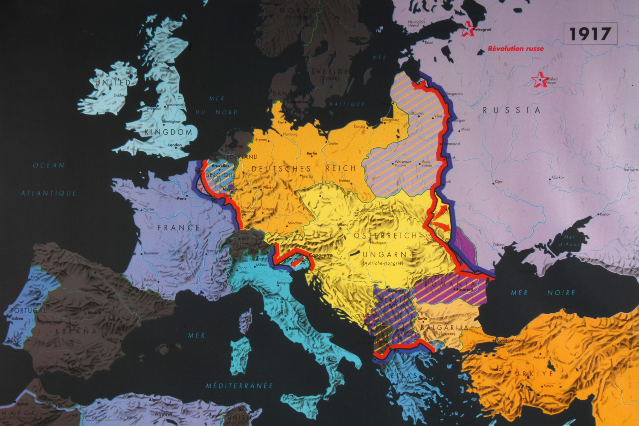
Eastern Front
Western Front
Salonika Front/Macedonian Front
Notes:
Teacher notes:
What is a ‘Front’ or ‘Frontline’? “What is a Front?” - In a military context, a "front" refers to the line of contact between two opposing forces or a geographical area where armies are engaged in conflict
The Salonika Front was a long way from the most famous front – the Western Front in France.

Slide 20
Part 2
Living in the Birdcage
Notes:
Teacher notes:

Slide 21
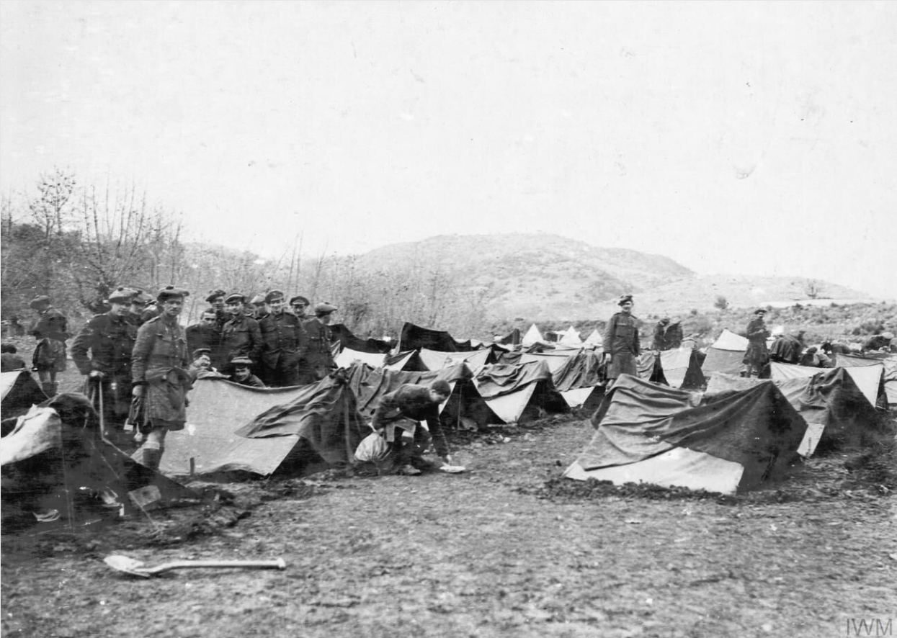
Life for British Soldiers
British soldiers live in rough camps with limited supplies
Poor roads make it hard to move food, weapons, and medicine
Extremes of weather make life difficult
There is very little chance of leave to visit family back home.
Notes:
Teacher notes:
Link this to earlier slides on terrain. Ask pupils to imagine daily life without proper shelter or supplies.

Slide 22
‘Marching is very hot and tiring and we get a thirst which no amount of drinking will satisfy; our water bottles are very precious things. Our bottles are filled before moving off and no man must drink until the order is given, although we get a longing to empty the bottle in one glorious drink.
The water men have difficulty in keeping up the supply, which has to be carried in leather bags on the mules. We go a long way up the Seres Road, one of the few decent roads in the country, then branch off…
I begin to lose interest in life and when we lie down again would like to stay there and die, but there is some strange force which says “stick it” until you drop from sheer exhaustion… Through the endless night we put one foot in front of the other, aching in every joint’.
Diary of Private George Veasey
8th Battalion The Oxfordshire and Buckinghamshire Light Infantry
July 1916
Notes:
Teacher notes:
Marching during the day was often not possible due to the extreme heat. Night marches were an alternative but still not easy as this testimony shows.
Source: National Army Museum

Slide 23
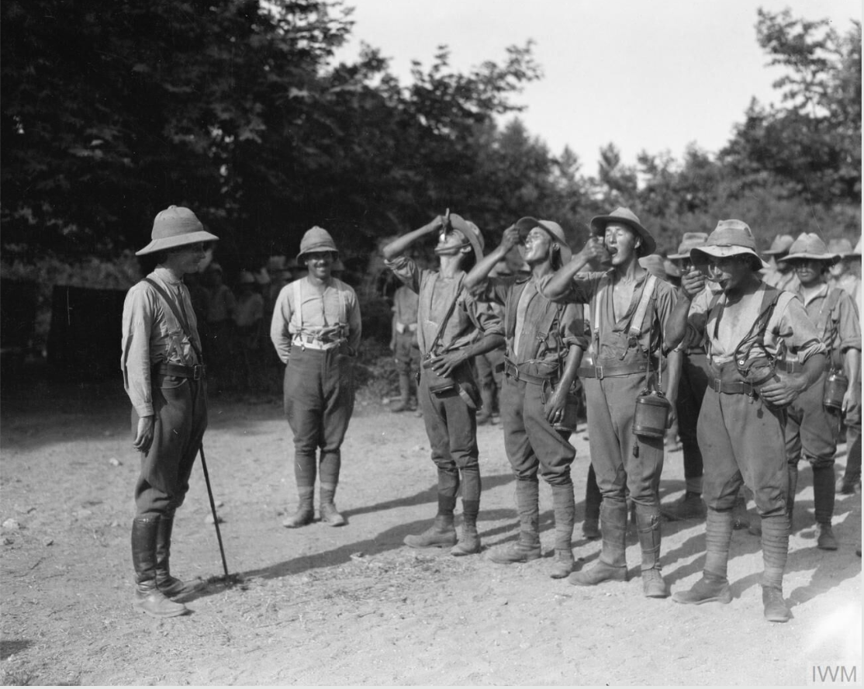
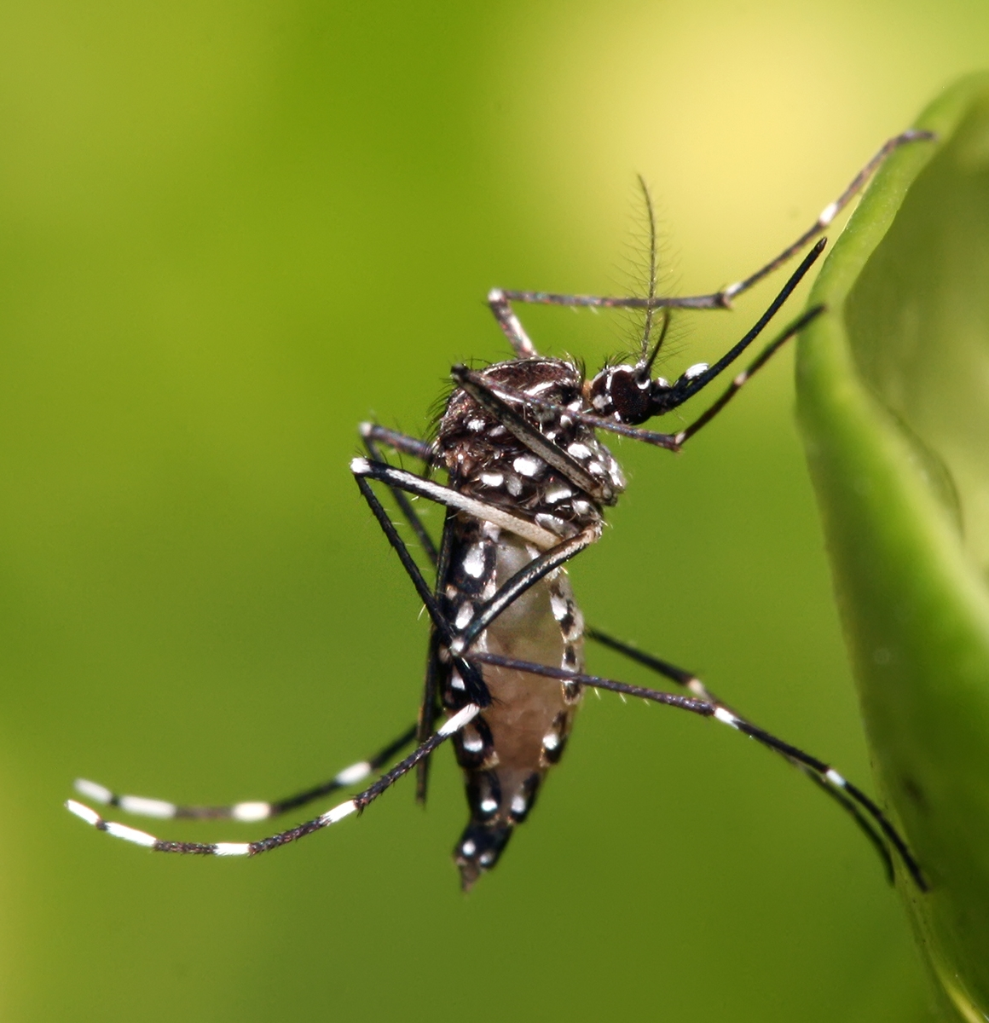
Malaria and Disease
Disease is one of the biggest dangers for British soldiers
Malaria is common because of mosquitoes in wet areas
Thousands of soldiers become sick, and many are sent home.
To protect against malaria, British Salonika Force troops took a daily dose of quinine. There were 162,517 cases of malaria.
Notes:
Teacher notes:
Explain that malaria is spread by mosquitoes, not person to person. Emphasise that disease caused more casualties than enemy bullets on this front. Throughput the campaign the British Salonika force suffered 481,000 non-battle causalities, 162,000 of these were victims of malaria. This total is 20 times more than the number of battle casualties.

Slide 24
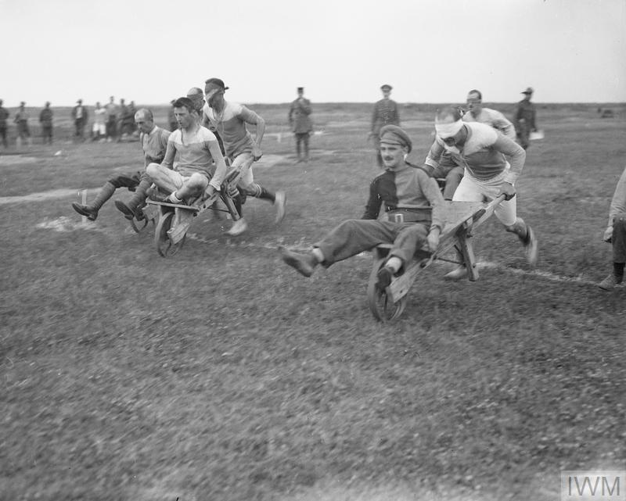
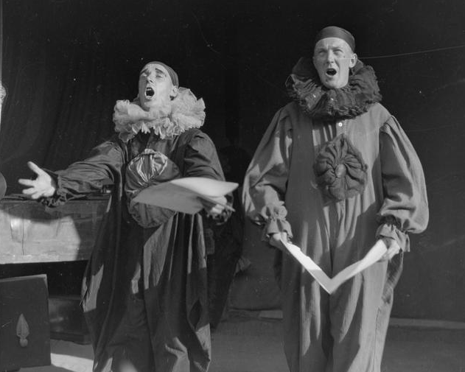
Boredom in the Birdcage
Most fighting is in raids, patrols and skirmishes
Boredom can affect morale
Theatre productions are popular
Sports and sporting competitions are organised.
Notes:
Teacher notes:
Old saying: “War is 90% boredom and 10 % terror ”
Image source IWM

Slide 25
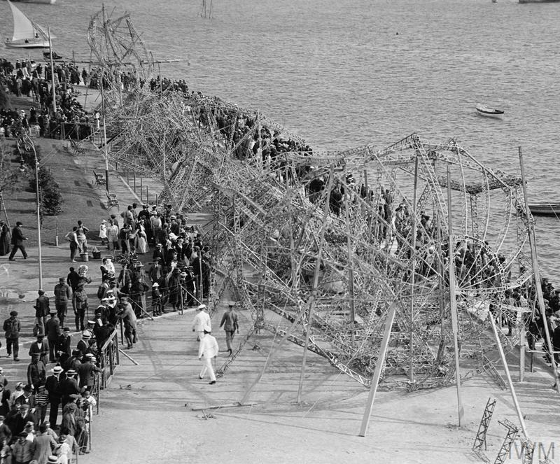
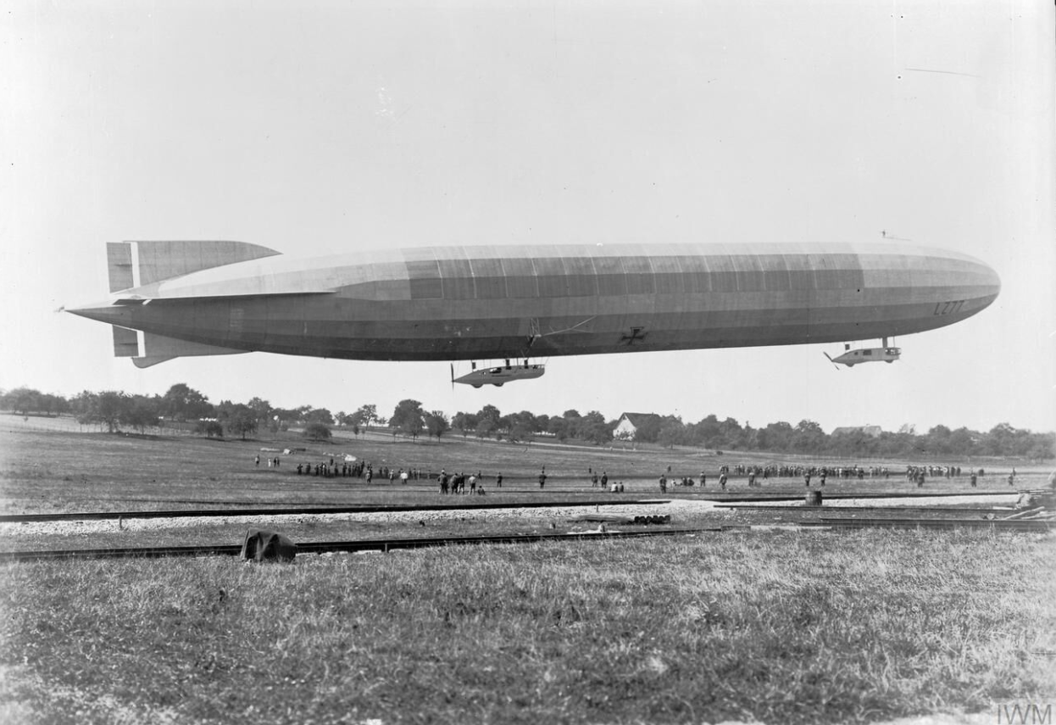
Excitement in the Birdcage
Zeppelins were huge gas-filled balloons
5 May 1916, Zeppelin LZ 85 is shot down as it tries to bomb Salonika.
Notes:
Teacher notes:
Old saying: “War is 90% boredom and 10 % terror ”
Images source IWM
The main image links to a film at the IWM: https://www.iwm.org.uk/collections/item/object/1060000196

Slide 26
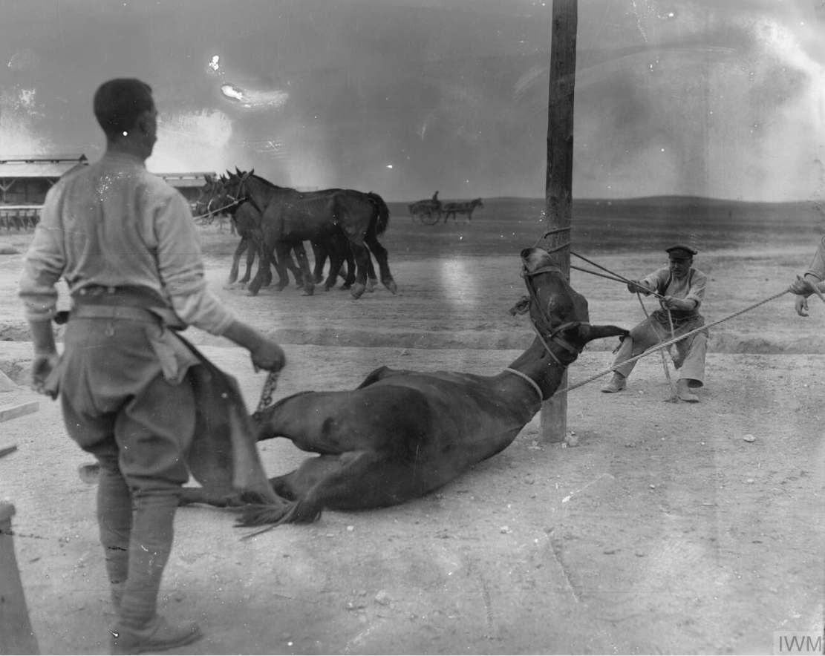
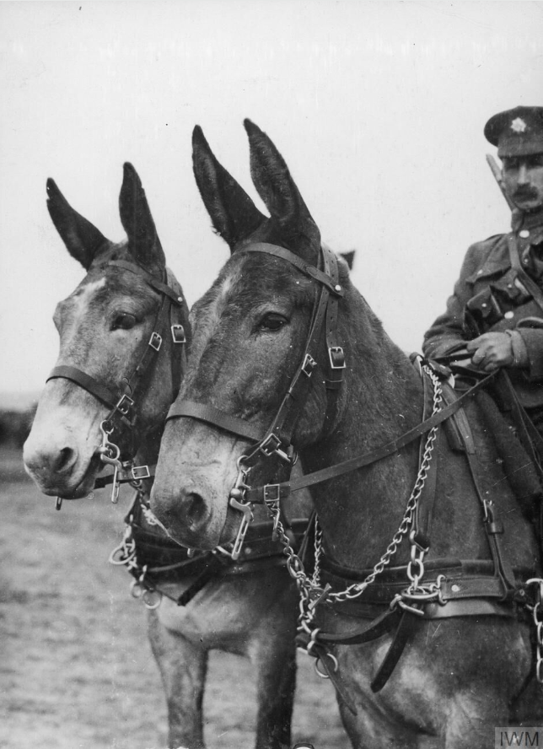
The Role of Animals
Animals are essential to the campaign.
Mules carry supplies across steep mountain paths where vehicles can not travel.
Army Veterinary Corps staff preparing to shoe a mule at a British Army veterinary hospital near Salonika, April 1916.
Notes:
Teacher notes:
Highlight how technology had limits in WWI. Mules were reliable and could cope with conditions that machines could not.
Pupils might be interested in the national memorial to animals in war: https://animalsinwar.org.uk/

Slide 27
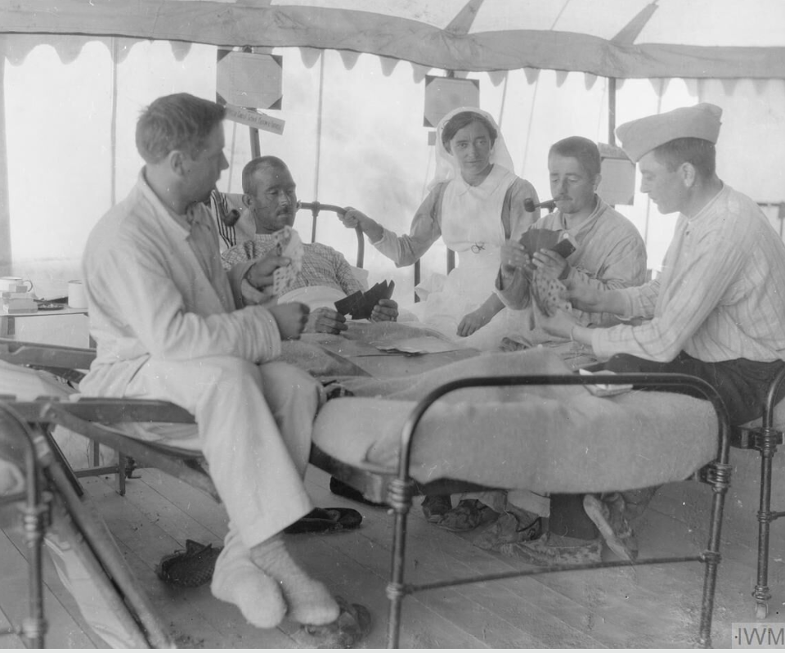
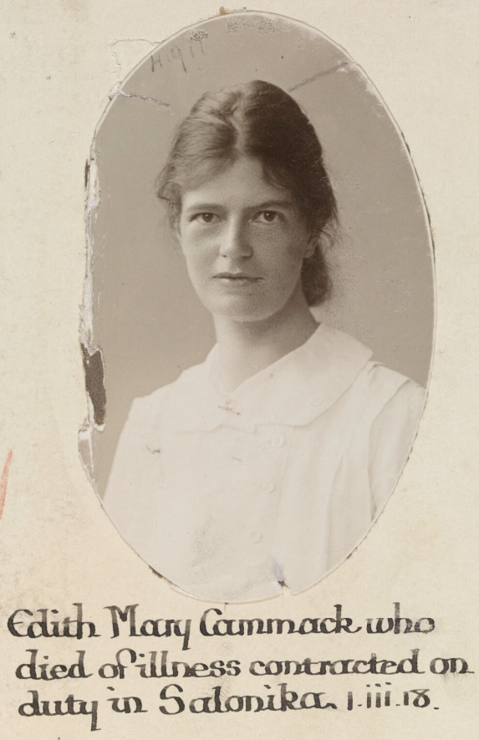
Women and Nursing
British, Australian, New Zealand and Canadian women serve as nurses in military hospitals.
They care for wounded and sick soldiers and work long hours in difficult and dangerous conditions.
Notes:
Teacher notes:
Mention organisations such as the Queen Alexandra’s Imperial Military Nursing Service. This may be a good point to discuss women’s changing roles during the war.

Slide 28
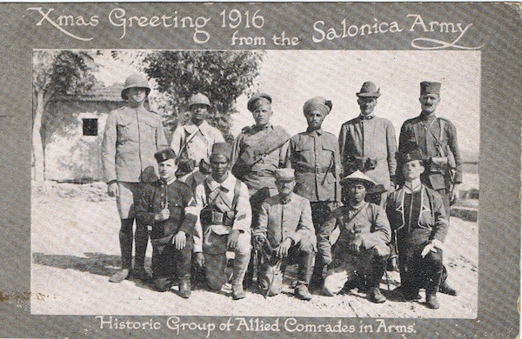
Soldiers From Around the World
The Salonika Campaign involves soldiers from many countries.
British troops fight alongside French, Serbian, Greek, Italian, and soldiers from across the British Empire
This makes Salonika one of the most international fronts of the war.
French North African
Italian
Serbian
British
Russian
Indian
French North African
French Indochina
Crete
French
Crete
Notes:
Teacher notes:
Point out how international this front was. Pupils may assume armies fought alone; this shows cooperation between nations. It was known as “The Army of the Orient”
Soldiers of the Allies at Salonika in 1916:
Back row: British (who else in those shorts!); French North African (Tirailleurs Algériens); Russian infantry; Indian Army (possibly from a mountain battery); Italian Alpini; Serbian infantry.
Front row: Cretan Gendarme; French West African (Tirailleurs Sénégalais); French (from a mounted branch); French Annamite (Indochina); Cretan Gendarme.
Source: https://salonikacampaignsociety.org.uk/2016/12/23/christmas-2016/

Slide 29
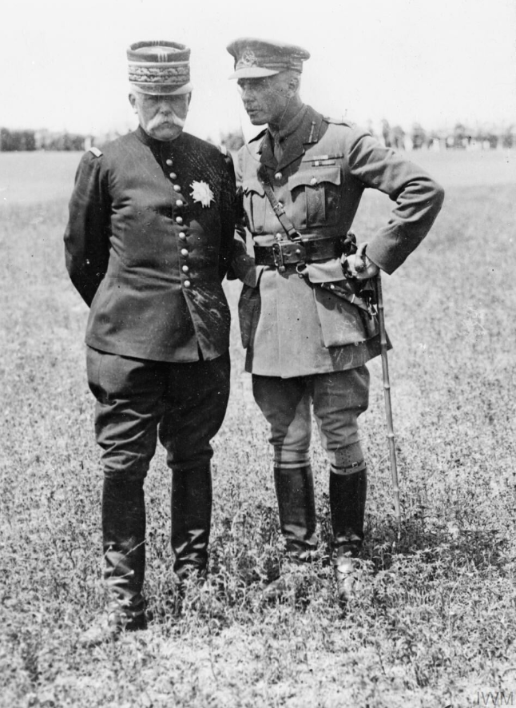
Key Leaders (1)
May 1916
General Sarrail (France) has overall command in Salonika
General Sir George Milne commands British forces.
General Sarrail, commander of Allied forces in Macedonia (16 January 1916 - 22 December 1917), with General Sir George Milne, commander of the British Salonika Force from 9 May 1916.
Notes:
Teacher notes:
Avoid focusing only on famous individuals. Emphasise collective effort and leadership responsibility. Reminder of the international nature of the campaign.

Slide 30
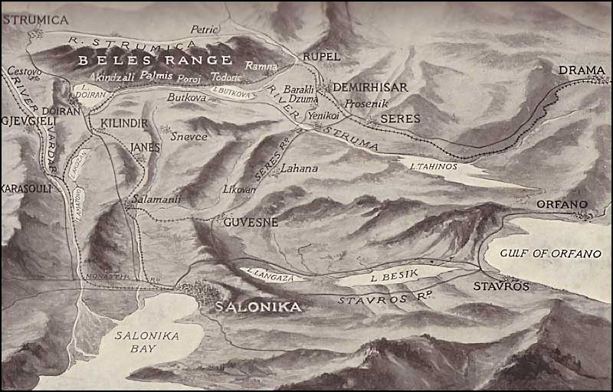
British Positions in Salonika
East of the Vardar River
The trenches west of Lake Doiran
The Struma Valley to the east
French and other allies held positions further west.
Notes:
Teacher notes:

Slide 31
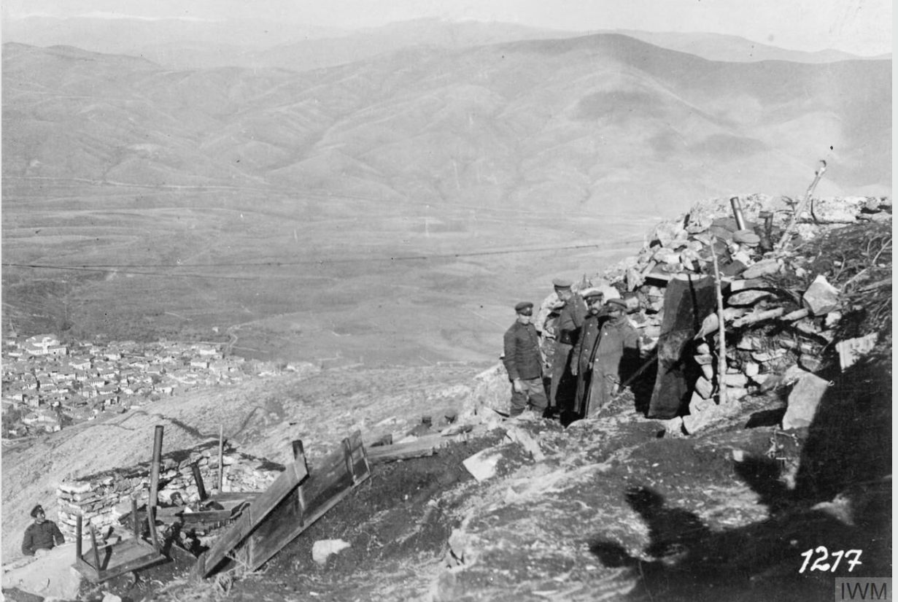
A Formidable Enemy…
The Bulgarian army
Holds the high ground
Has built strong defences
The Bulgarian army is
Well-trained
Experienced
Well-equipped.
Bulgarian observation and machine gun post on Hill 1050 just north of Monastir. This position was captured by Serbian forces on 20 November 1916.
Notes:
Teacher notes:
Image source IWM

Slide 32
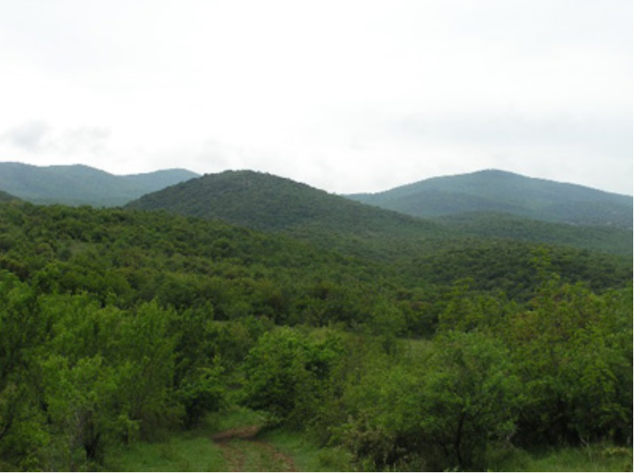
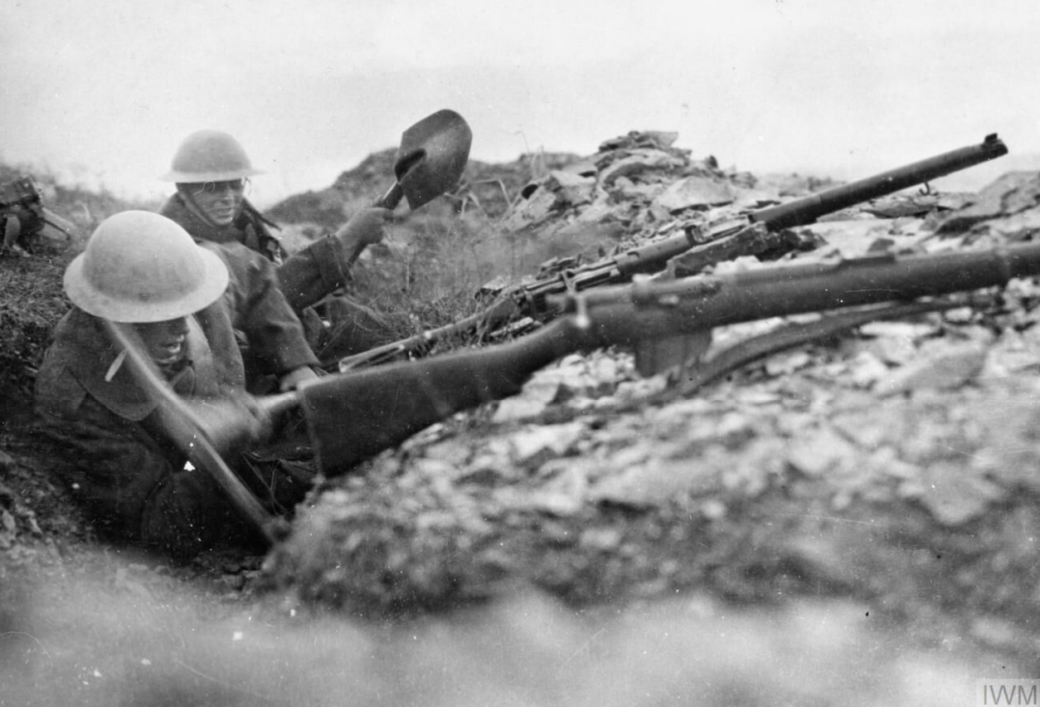
Doiran & the Vardar
A land of rocky hills & deep ravines & the area of the heaviest fighting
April & May 1917 the British attack the strong Bulgarian defences around Doiran
The attack fails
Many killed and wounded – 35% of all British casualties in Salonika .
Two British infantrymen attempt to deepen a trench using pick and shovel in the rocky terrain around Doiran.
Notes:
Teacher notes:
View across the Doiran battlefield - Petit Couronné in centre With Pip Ridge and Grand Couronné on the skyline to left and right
The Salonika Campaign was fought along a 250 mile front, running from Albania to the mouth of the River Struma in Greece. Here were found wide open valleys and plains, tangled masses of hills and ravines such as those at Doiran and towering mountains.
Image source:
IWM
https://www.theculturalexperience.com/defining-features-and-hardships-of-the-salonika-campaign.php

Slide 33
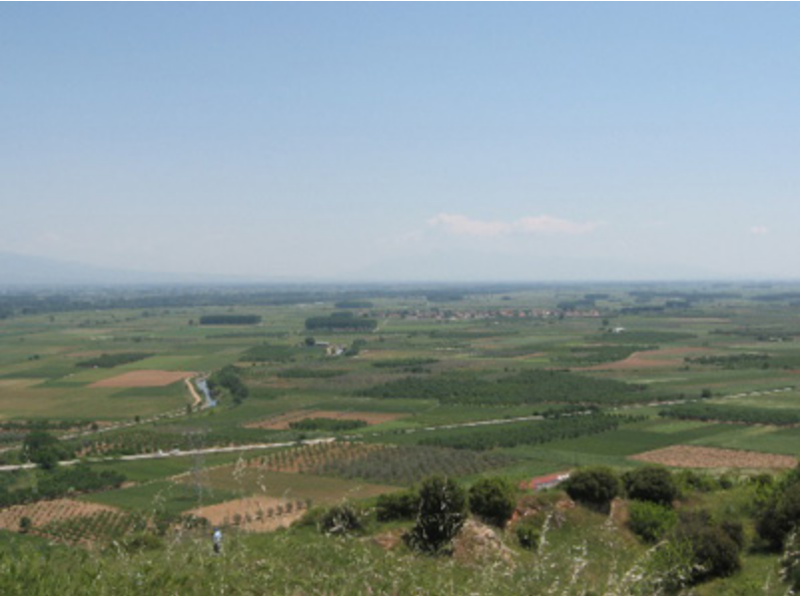
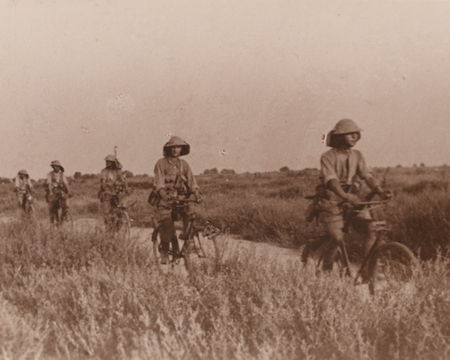
The Struma Valley
Infested with malaria-carrying mosquitoes
In the summer, both the British and Bulgarian forces are often forced to withdraw from the valley floor into the hills
Fighting largely consists of patrols, raids, and limited attacks
In September 1916, the British XVI Corps capture the village of Karajakoi.
Notes:
Teacher notes:
The wide, flat expanse of the Struma Valley
Image source:
IWM
https://www.theculturalexperience.com/defining-features-and-hardships-of-the-salonika-campaign.php

Slide 34
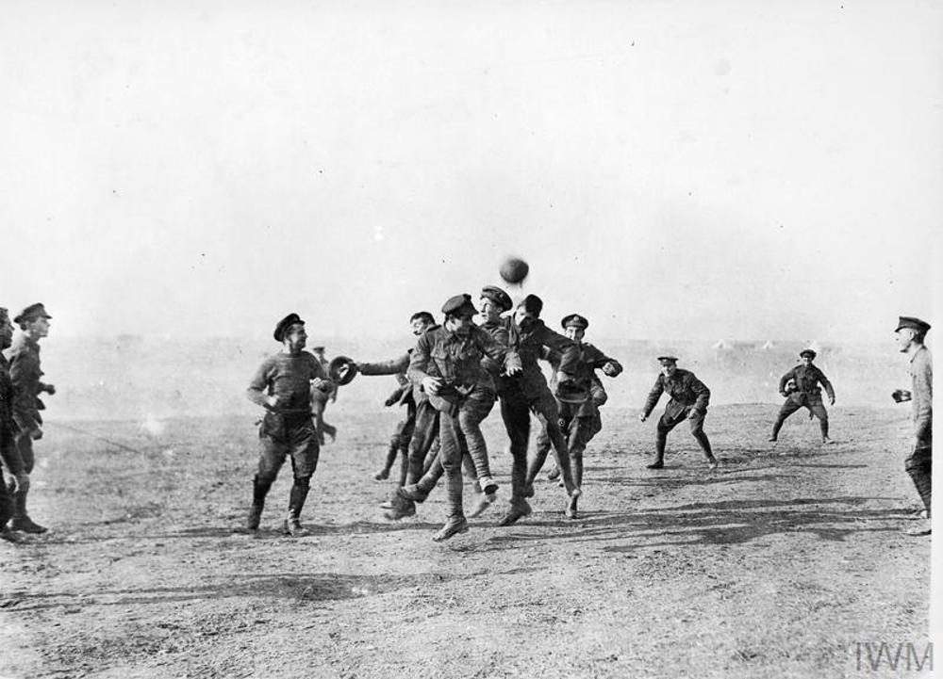
How Britain Views the Campaign
Many people in Britain know little about Salonika.
Some call it a “sideshow”
Many believe soldiers are needed more urgently in France.
Notes:
Teacher notes:
Discuss media influence and public opinion. Ask why some campaigns become better remembered than others.

Slide 35
Part 3
The Final Breakthrough
& Legacy
Notes:
Teacher notes:

Slide 36
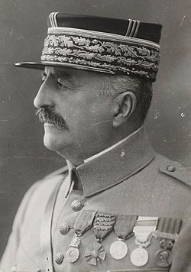
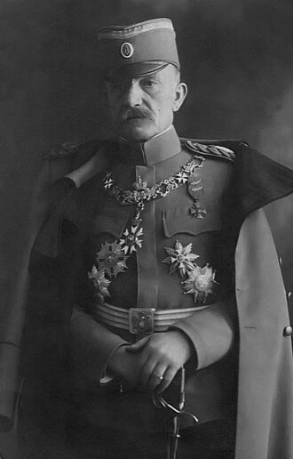
Key Leaders (2)
1918
British still led by General Sir George Milne
French General Sarrail is replaced by General Franchet d'Espèrey.
The British soldiers call him “Desperate Frankie”!
Serbian army (now recovered and back from Corfu) is led by Field Marshal Živojin Mišić.
Notes:
Teacher notes:
In June 1918, a new Allied commander arrived at Salonika. French General Franchet d’Espèrey was a man who knew the Balkans and he was looking for a path to victory. Nicknamed ‘Desperate Frankie’ by British troops, d’Espèrey toured the front line and was soon talking with Serbian commander, Field Marshal Mišić.

Slide 37
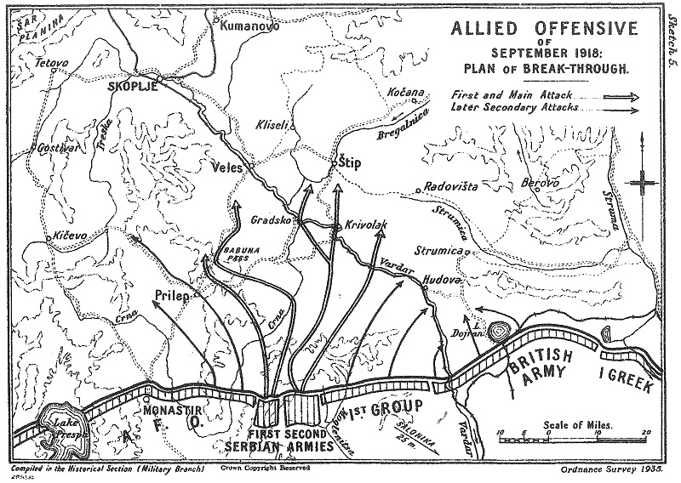




A New Plan to Break Through…
French and Serbs to punch through centre of Bulgarian frontline
Capture Gradsko and Krivolak railheads
British & Greek to attack at Doiran…
To stop Bulgarians reinforcing their centre.
Notes:
Teacher notes:
d’Espèrey and Mišić hatch a plan to capture the key Bulgarian railheads at Gradsko and Krivolak, 35 miles behind the frontline.
Taking these two strategic points would dislocate the Bulgarian rail network all along the Salonika Front and mean that the German and Bulgarian troops would have to pull back or be cut off without supplies.

Slide 38
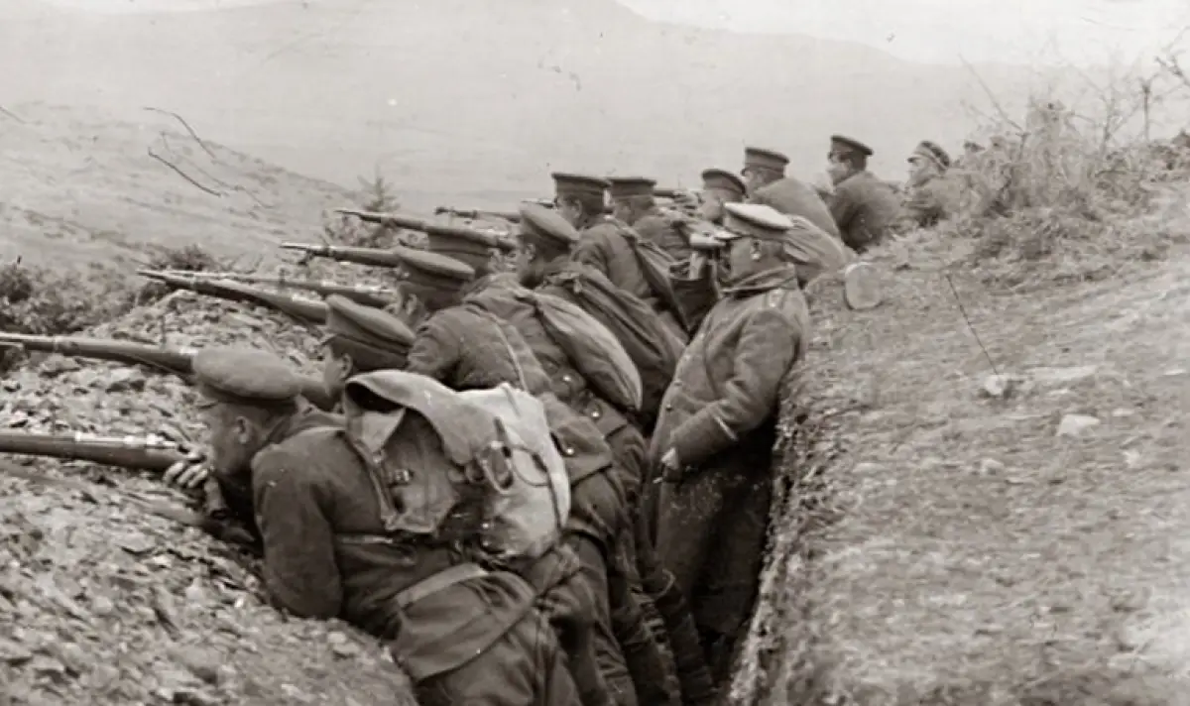
The Battle of Doiran 1918
15th September
French and Serbians attack enemy lines in the west
18th September
British & Greek troops in the east support the attack by…
Pinning down Bulgarian troops in the east for two days
British and Greeks suffer 7,103 casualties for little gain
However, not one Bulgarian soldier moves west to counter to the main Allied advance.
Notes:
Teacher notes:
To achieve this plan, French and Serbian troops attacked into the Moglena Mountains on the 15th of September 1918 and within four days had punched a hole in the Bulgarian lines and were moving out into the plains beyond.
As the Germans and Bulgarians tried to stem the Allied advance, British and Greek troops attacked at Doiran on the 18th of September.
The idea here was to pin the Ninth Pleven division to their front so that none of these Bulgarian troops could move west of the Vardar River to combat the French and Serbian advance.
In two days of hard fighting at Doiran, the British and Greeks suffered 7103 casualties for little gain. However not one Bulgarian soldier moved west of the Vardar River to counter to the main Allied advance.

Slide 39
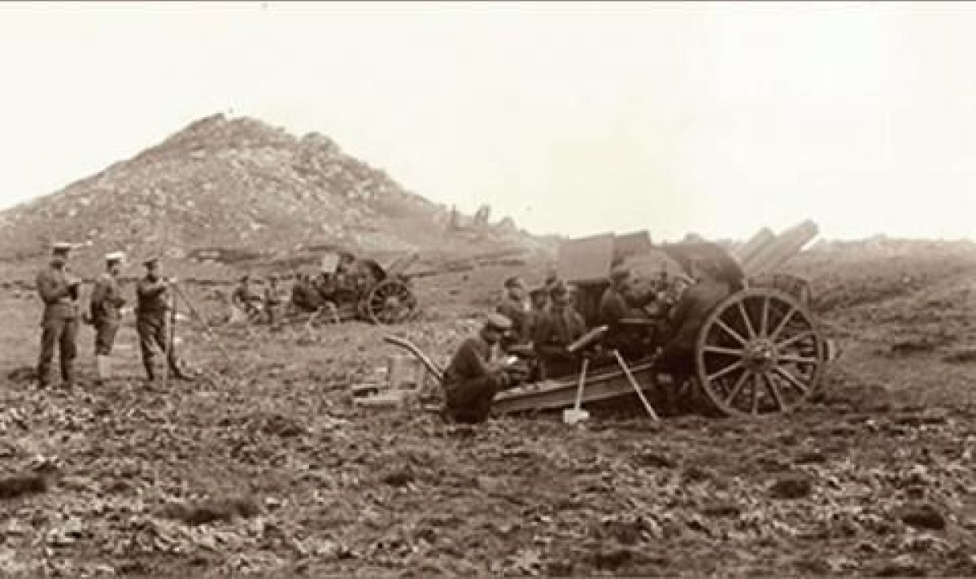
The Final Breakthrough!
21st September
British troops at Doiran discover the Bulgarians have abandoned their positions and are in retreat
The break-through plan has worked!
Notes:
Teacher notes:
Victory was now in sight and on the 21st of September, British troops at Doiran found the Bulgarians had abandoned their positions and were in retreat.
The Bulgarian army was caught by aircraft of the Royal Air Force in mountain passes near Strumitza and bombed and machine-gunned, and their retreat was turned into a rout.
Evidence of this action was found with British troops following the Bulgarian advance when they found abandoned vehicles, smashed equipment and dead horses strewn along the roadside.
Unable to stop the Allied advance, and with their army disintegrating, the Bulgarian government called for an armistice. This was signed on the 29th of September and came into force at noon the following day. However, these dramatic events in the Balkans were quickly forgotten with the coming of the signing of the armistice with Germany on the 11th of November 1918, which brought the First World War to a close.

Slide 40
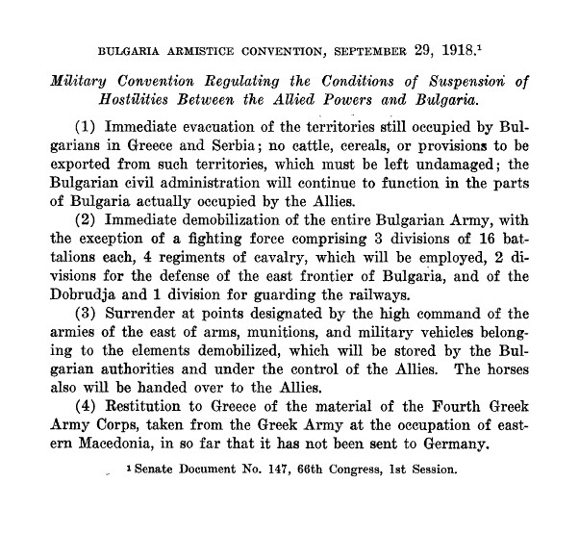
Armistice Signed
29th September
Bulgaria signs armistice to end the war with Allies
11th November
Final armistice with Germany which ends the First World War.
Notes:
Teacher notes:
Unable to stop the Allied advance, and with their army disintegrating, the Bulgarian government called for an armistice.
This was signed on the 29th of September and came into force at noon the following day.
However, these dramatic events in the Balkans were quickly forgotten with the coming of the signing of the armistice with Germany on the 11th of November 1918, which brought the First World War to a close.

Slide 41
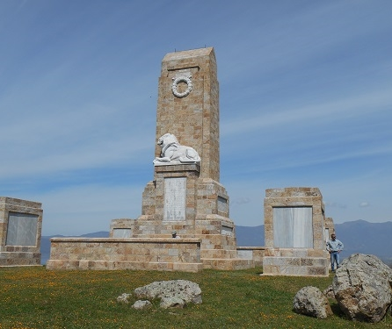
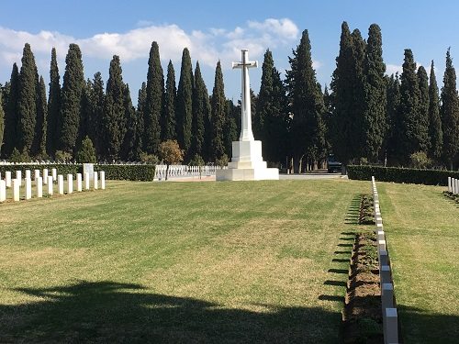
Legacy of the Salonika Campaign
The Salonika Campaign helped weaken the enemy and shorten the war. Today it reminds us that the First World War was fought in many places across the world.
Notes:
Teacher notes:
Conclude by reinforcing the idea of global warfare and remembrance. You may wish to link this to war memorials or local history.

Slide 42
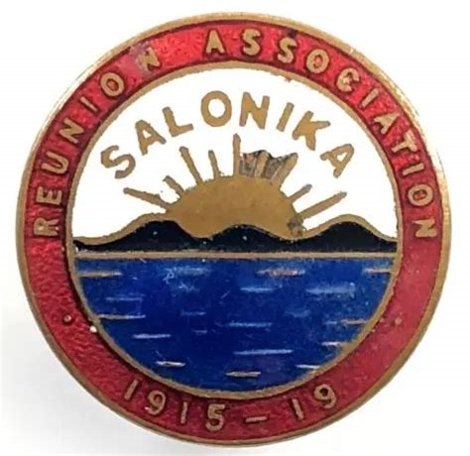

Salonika Reunion Association
Old comrades
1924(ish) – 1968
Salonika Campaign Society
Keep alive the memory of all those, of all nations, that served in the campaign
320 members across the world.
Notes:
Teacher notes:
Conclude by reinforcing the idea of global warfare and remembrance. You may wish to link this to war memorials or local history.

Slide 43
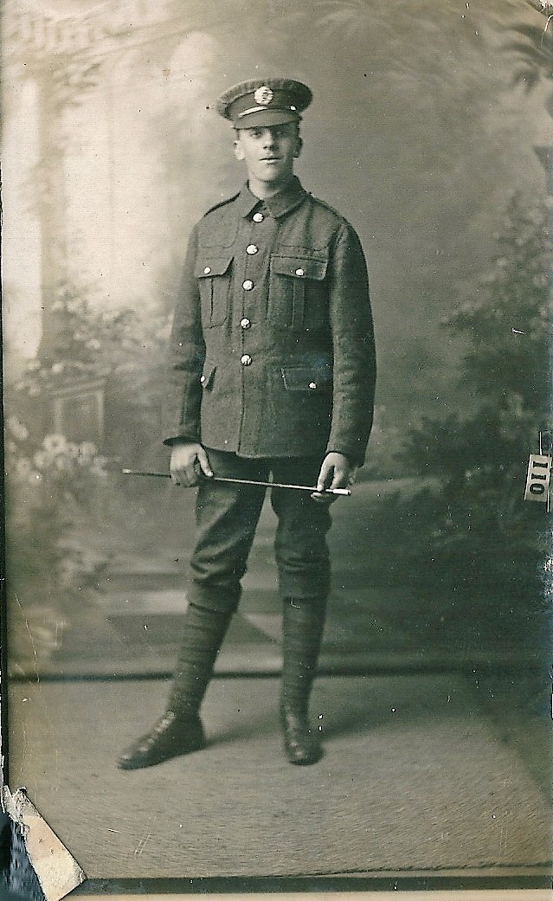
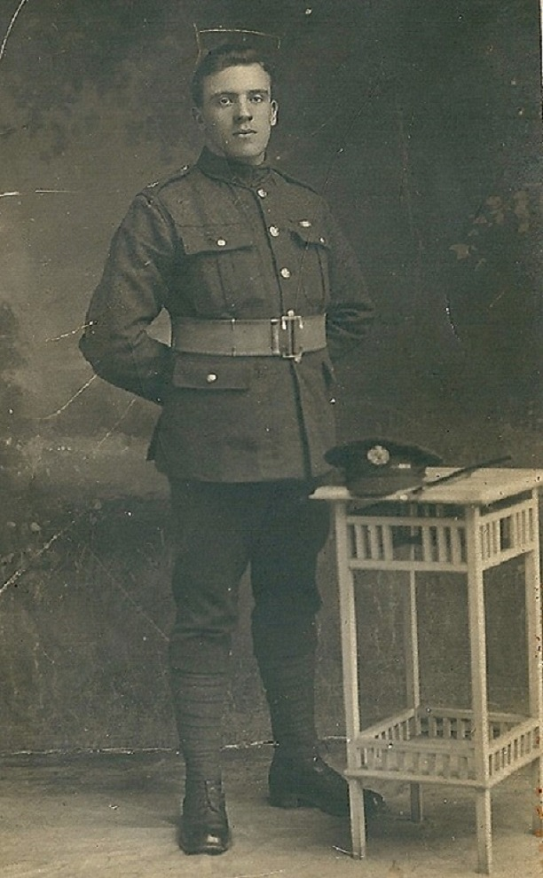
Arthur Jack Hutt ‘Pat’
1898-1978

Slide 44
Image Sources
Slide 20 - https://www.iwm.org.uk/collections/item/object/205217043
Slide 22 - https://www.dublin-fusiliers.com/salonika/1916-birdcage.html
Slide 23 - https://www.iwm.org.uk/collections/item/object/205297588 & https://www.iwm.org.uk/collections/item/object/205297452
Slide 24 - Image https://www.iwm.org.uk/collections/item/object/205297623 links to https://www.iwm.org.uk/collections/item/object/1060000196
Slide 25 - https://www.iwm.org.uk/collections/item/object/205212919 & mules https://www.iwm.org.uk/collections/item/object/205297517
Slide 26 - https://www.iwm.org.uk/collections/item/object/205380042 & https://www.iwm.org.uk/collections/item/object/205297499
Slide 27 - https://salonikacampaignsociety.org.uk/2016/12/23/christmas-2016
Slide 28 - https://www.iwm.org.uk/collections/item/object/205221850
Slide 29 - https://www.levantineheritage.com/salonicamap.htm
Slide 30 - https://www.iwm.org.uk/collections/item/object/205191924
Slide 31 - https://www.iwm.org.uk/collections/item/object/205221843
Slide 32 - https://collection.nam.ac.uk/detail.php?acc=1965-09-138-32
Slide 33 - https://www.iwm.org.uk/collections/item/object/205195297
Slide 1 - https://salonikacampaignsociety.org.uk/
Slide 2 - https://collection.nam.ac.uk/detail.php?acc=1978-11-157-29-6
Slide 4 - https://worldmapwithcountries.net/map-of-europe-political/
Slide 4 - https://archives.territoiredebelfort.fr/media/fee7d4c4-680b-48b4-ac01-fcd8f4b9f66d.pdf
Slide 5 - From Alan Wakefield and Simon Moody, Under the Devil’s Eye: Britain’s Forgotten Army in Salonika 1915-1918 (Stroud: Sutton Publishing, 2004)
https://www.vox.com/a/world-war-i-maps
Slide 7– https://www.reddit.com/r/imaginarymaps/comments/mtjxm1/no_lore_map_of_the_balkans_before_the_great_war/
Slide 9 - French Soldiers in Salonika. 1915, https://commons.wikimedia.org/wiki/File:French_soldiers-salonika-1915.jpg
Slide 10 - https://www.youtube.com/watch?v=49WAjn744hE
Slide 12 - https://en.wikipedia.org/wiki/Great_Retreat_%28Serbia%29
Slide 13 - https://collection.nam.ac.uk/detail.php?acc=1978-11-157-11-30
Slide 15 - https://www.iwm.org.uk/collections/item/object/205088298
Slide 16 - https://collection.nam.ac.uk/detail.php?acc=1997-02-18-23
Slide 17 - https://www.nam.ac.uk/explore/salonika-campaign
Slide 18 - https://www.historial.fr/en/resources-2/collections-and-the-documentation/resources/cartography-of-the-front-lines/
Slide 35 - & https://en.wikipedia.org/wiki/Louis_Franchet_d%27Esp%C3%A8rey & https://en.wikipedia.org/wiki/%C5%BDivojin_Mi%C5%A1i%C4%87
Slide 37 - https://fakti.bg/en/bulgaria/913353-20-septemvri-1918-g-balgaria-moli-za-primirie
Slide 38 - https://fakti.bg/en/world/811515-16-septemvri-1918-g-podvigat-na-deveta-plevenska-divizia-pri-doiran#goog_rewarded
Slide 39 - https://en.wikipedia.org/wiki/Armistice_of_Salonica

