Slide 1
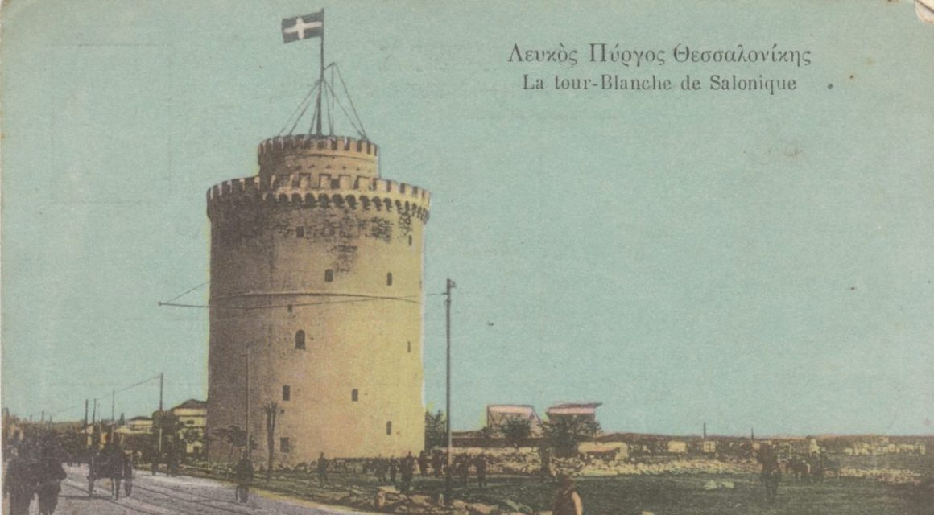
Salonika
1915-1918
Notes:
Teacher notes:
Emphasise that WWI was global, not just fought in France and Belgium. This campaign is sometimes called a “forgotten front,” which helps explain why pupils may not have heard of it before.

Slide 2
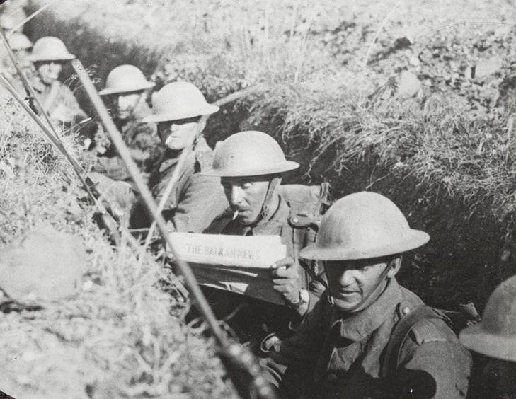
Salonika Campaign 1915-1918
The Salonika Campaign was part of the First World War and was fought from 1915 to 1918. British soldiers fought alongside allies in Greece, far from the better-known battles in France.
Notes:
Teacher notes:
Emphasise that WWI was global, not just fought in France and Belgium. This campaign is sometimes called a “forgotten front,” which helps explain why pupils may not have heard of it before.

Slide 3
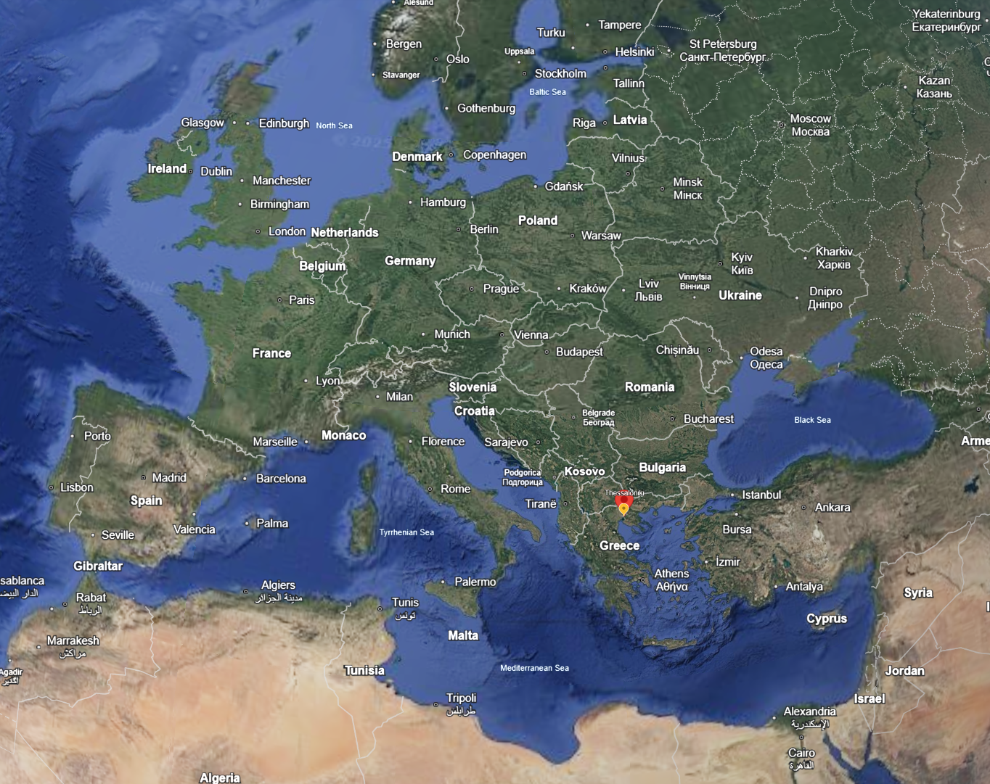
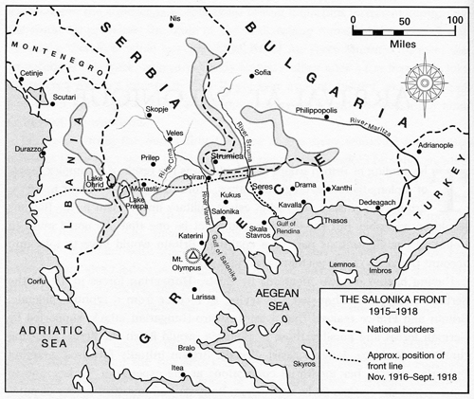
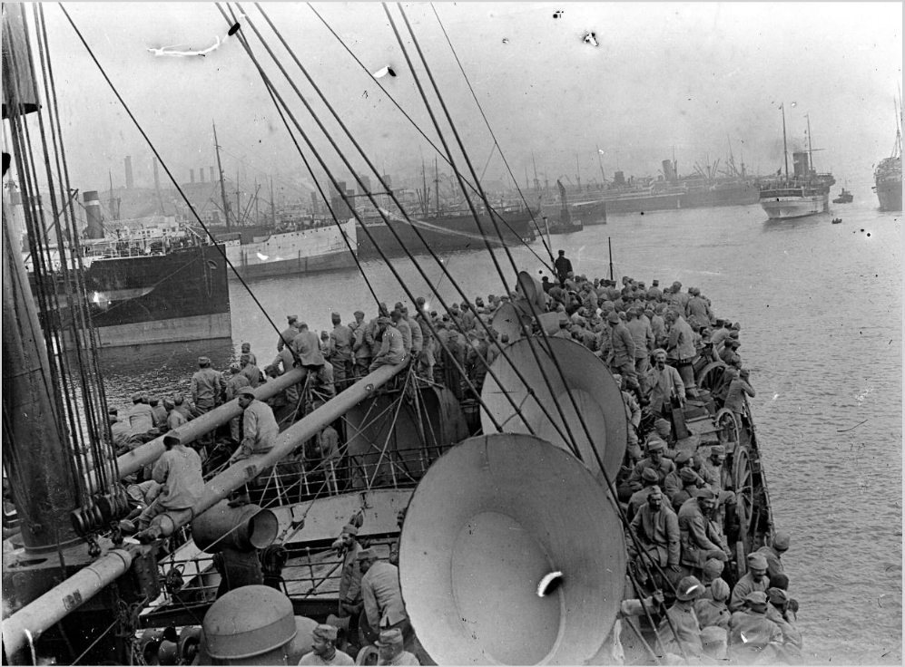

Where Is Salonika?
Google Earth
Salonika, now called Thessaloniki, is a port city in northern Greece. Its harbour made it an important place for Allied ships to land troops and supplies.
Notes:
Teacher notes:
Use a map to show Greece, the Balkans, and the Mediterranean. Highlight that ports were crucial in WWI for moving men and materials.

Slide 4
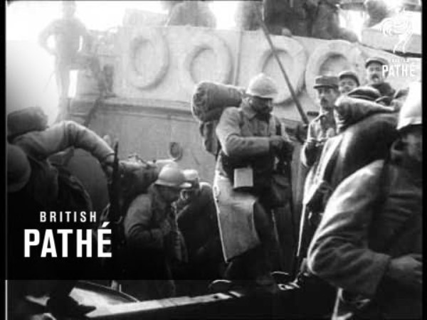
French troops arrive in Salonika, 1915

Slide 5
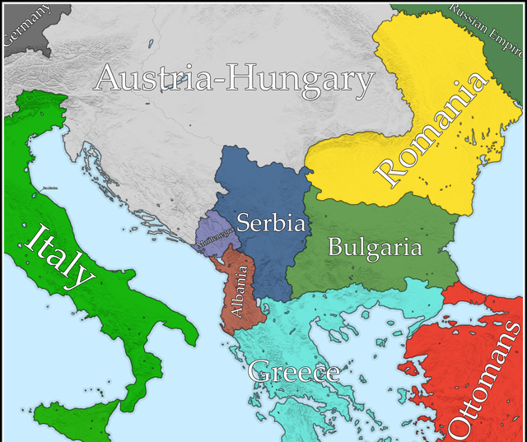
Events Leading to British Involvement
In 1915, Bulgaria joined the war against Serbia. Serbia was overwhelmed.
Britain and its Allies decided to send troops to Greece to help Serbia, even though Greece was officially neutral.
Notes:
Teacher notes:
Explain alliances simply: who was on which side and why Serbia mattered. Note that Greece was officially neutral at first, which made the decision risky.
Clarify the idea of a “front.” Explain that opening new fronts was meant to stretch enemy armies and reduce pressure elsewhere.

Slide 6
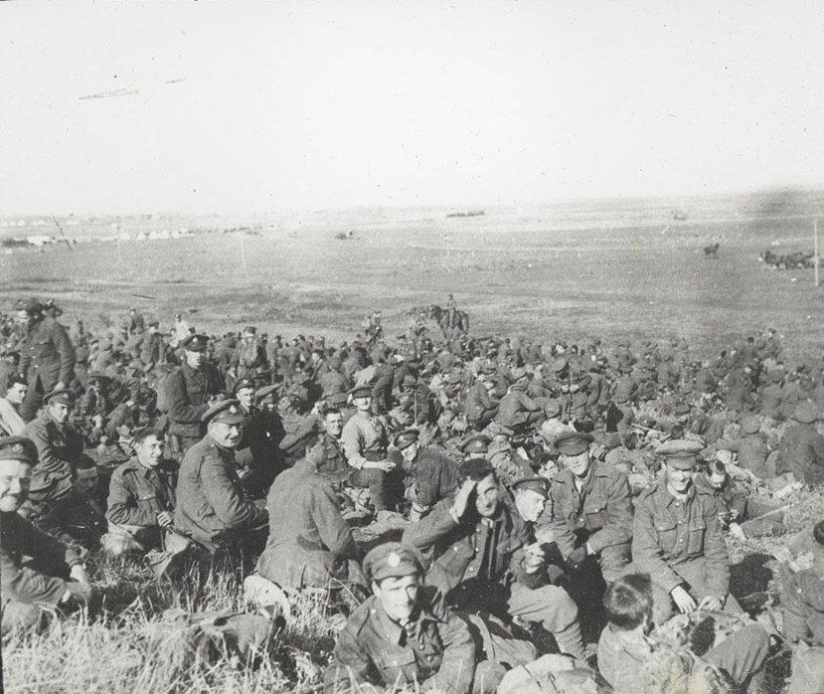
British Forces Arrive (1915)
British and French troops landed at Salonika in late 1915. They arrived too late to save Serbia and instead had to defend the area around the city.
They were not equipped for winter in the mountains and by the end of November, more than 1,600 men had been evacuated, many suffering from frostbite.
Notes:
Teacher notes:
Stress the frustration of arriving too late. This helps pupils understand why some people later criticised the campaign.

Slide 7
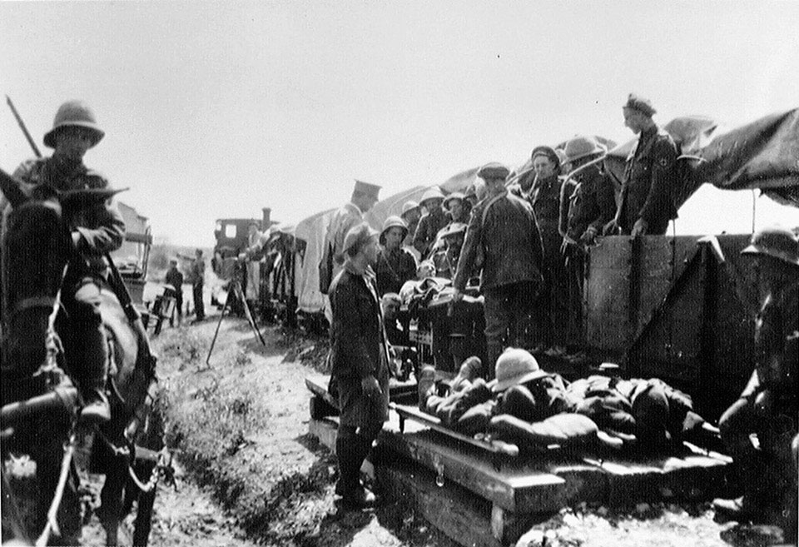
Fighting and Conditions (1916–1917)
Most fighting was slow and difficult. Soldiers faced mountains, extreme weather, and dangerous diseases like malaria. Many men became sick rather than wounded.
Wounded being sent to hospital on a light railway, 1916
Notes:
Teacher notes:
Compare this terrain to the Western Front. Discuss how geography affects warfare.

Slide 8
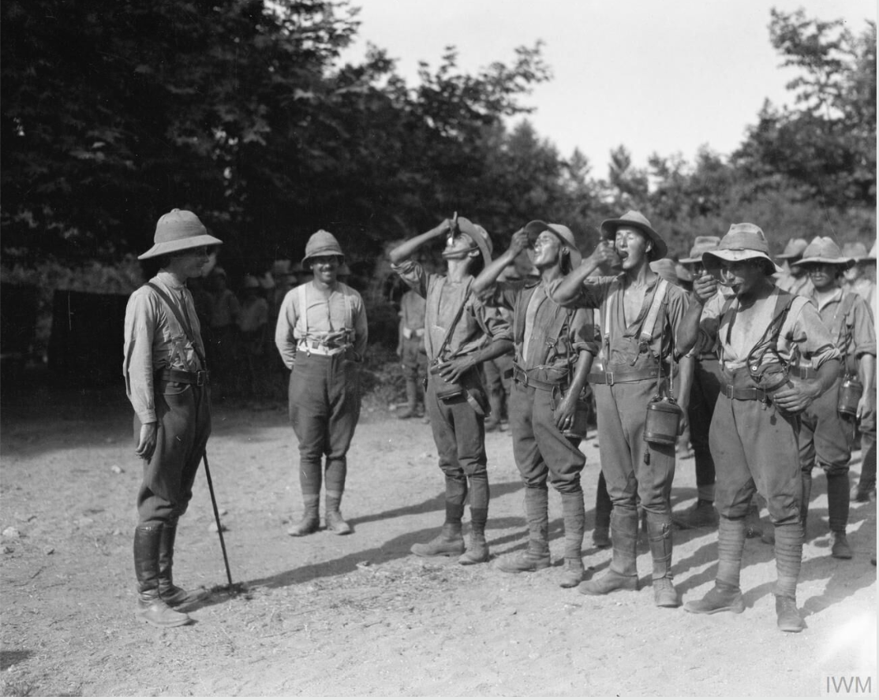
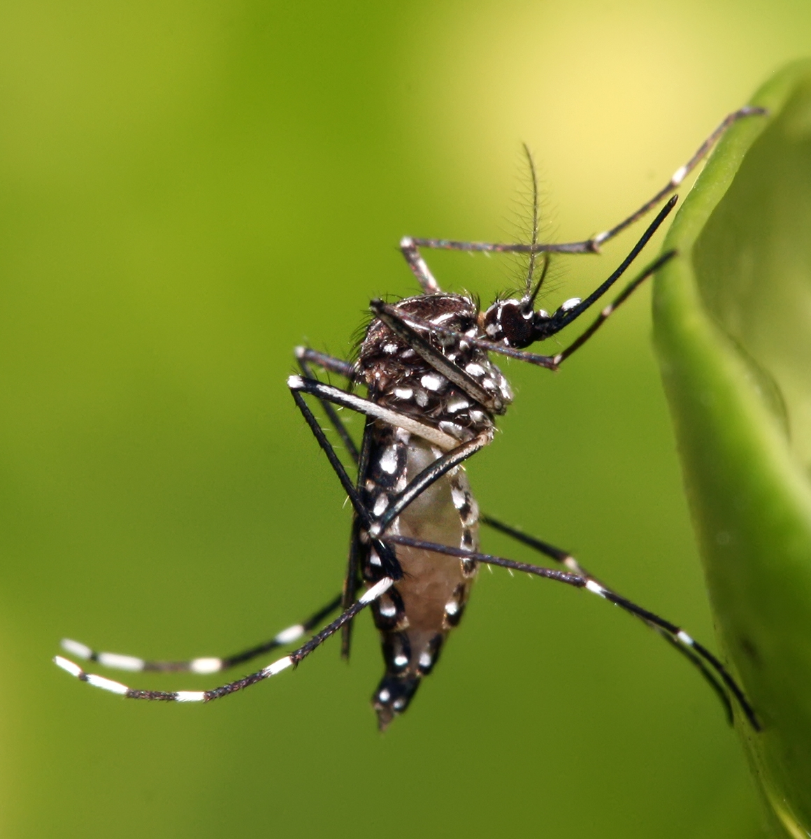
Malaria and Disease
Disease was one of the biggest dangers for British soldiers. Malaria was common because of mosquitoes in wet areas. Thousands of soldiers became sick, and many were sent home.
To protect against malaria, British Salonika Force troops took a daily dose of quinine. There were 162,517 cases of malaria.
Notes:
Teacher notes:
Explain that malaria is spread by mosquitoes, not person to person. Emphasise that disease caused more casualties than enemy bullets on this front.

Slide 9
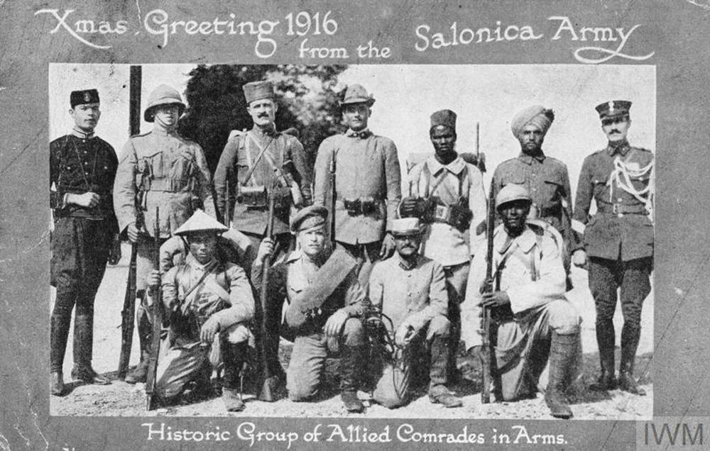
Soldiers From Around the World
The Salonika Campaign involved soldiers from many countries. British troops fought alongside French, Serbian, Greek, Italian, and soldiers from across the British Empire. This made Salonika one of the most international fronts of the war.
Notes:
Teacher notes:
Point out how international this front was. Pupils may assume armies fought alone; this shows cooperation between nations.

Slide 10
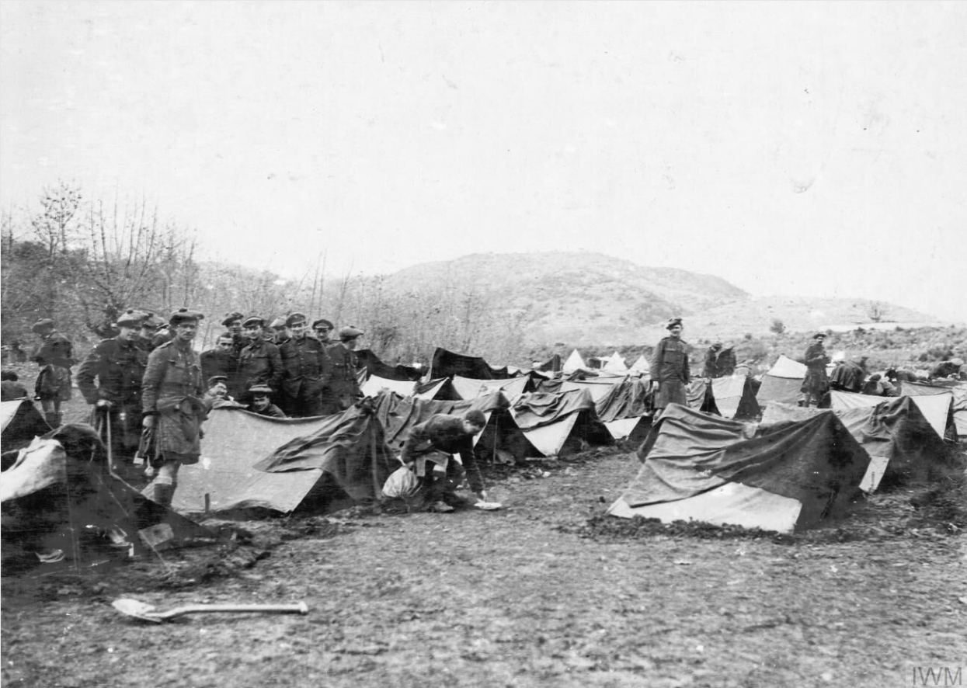
Life for British Soldiers
British soldiers lived in rough camps with limited supplies. Poor roads made it hard to move food, weapons, and medicine to the front line.
Notes:
Teacher notes:
Link this to earlier slides on terrain. Ask pupils to imagine daily life without proper shelter or supplies.

Slide 11
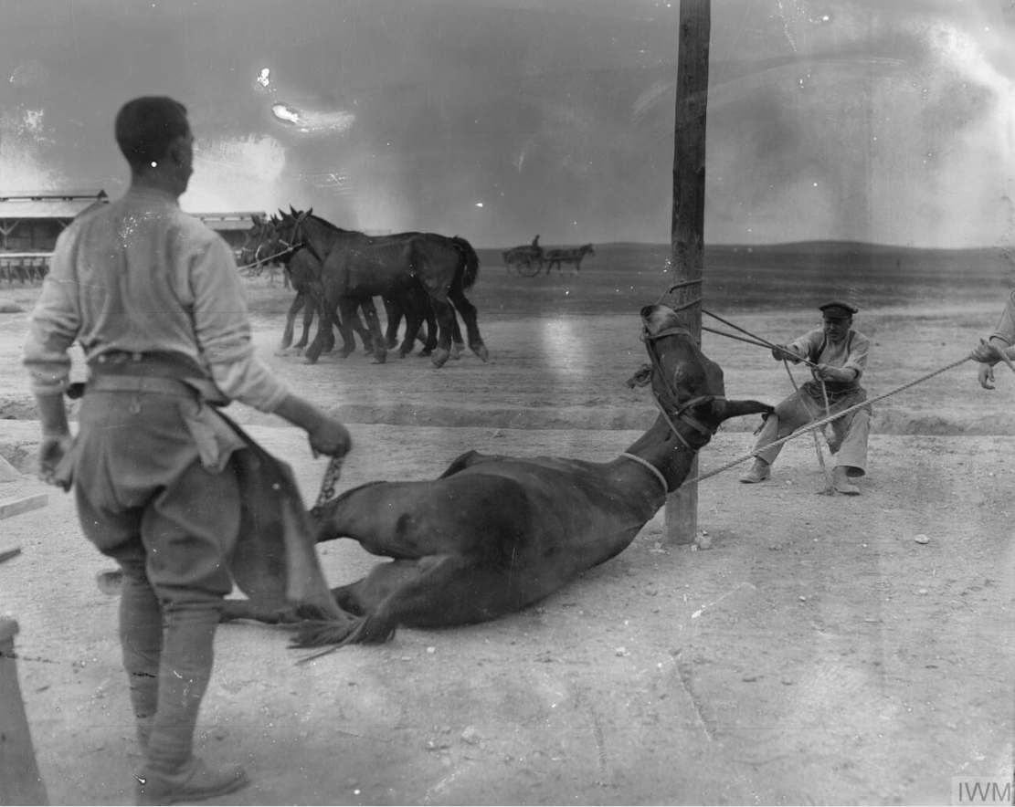
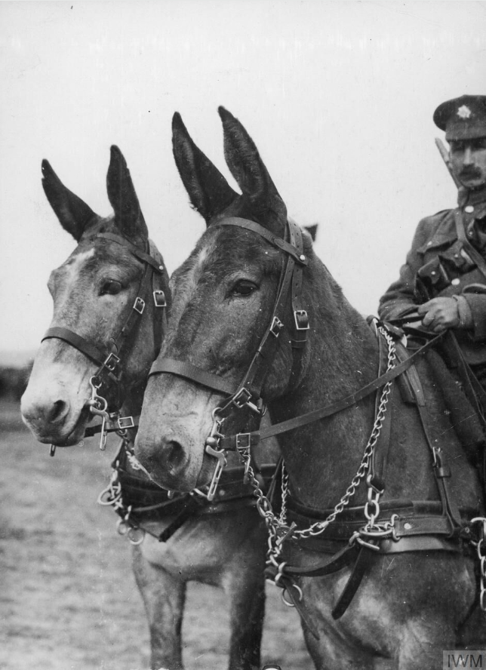
The Role of Animals
Animals were essential to the campaign. Mules carried supplies across steep mountain paths where vehicles could not travel.
Army Veterinary Corps staff preparing to shoe a mule at a British Army veterinary hospital near Salonika, April 1916.
Notes:
Teacher notes:
Highlight how technology had limits in WWI. Mules were reliable and could cope with conditions that machines could not.

Slide 12
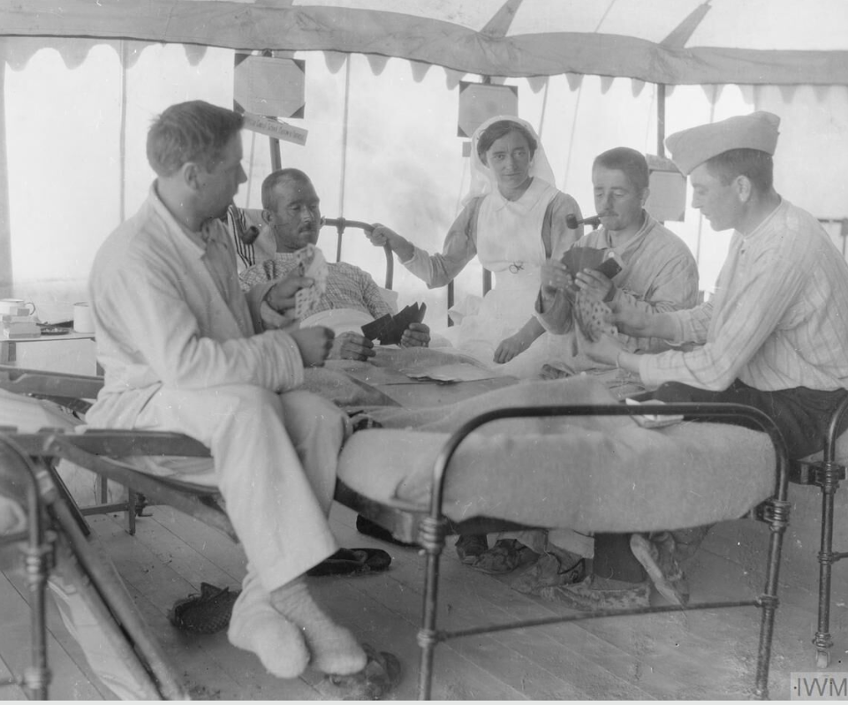
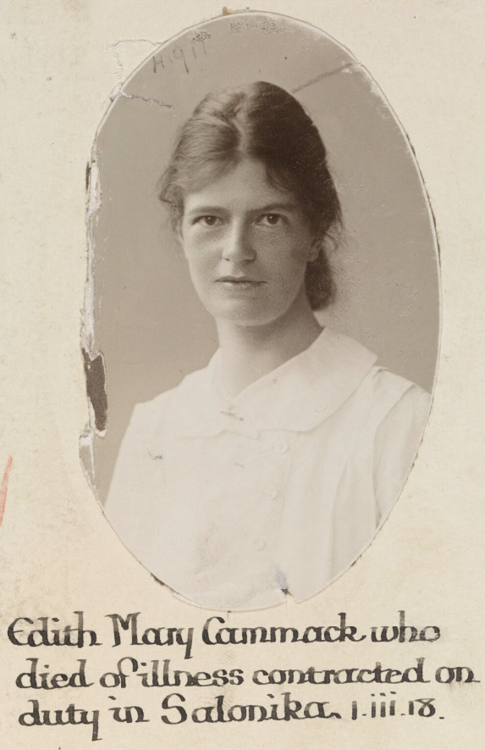
British Women and Nursing
British women served mainly as nurses in military hospitals. They cared for wounded and sick soldiers and worked long hours in difficult and dangerous conditions.
Notes:
Teacher notes:
Mention organisations such as the Queen Alexandra’s Imperial Military Nursing Service. This is a good point to discuss women’s changing roles during the war.

Slide 13
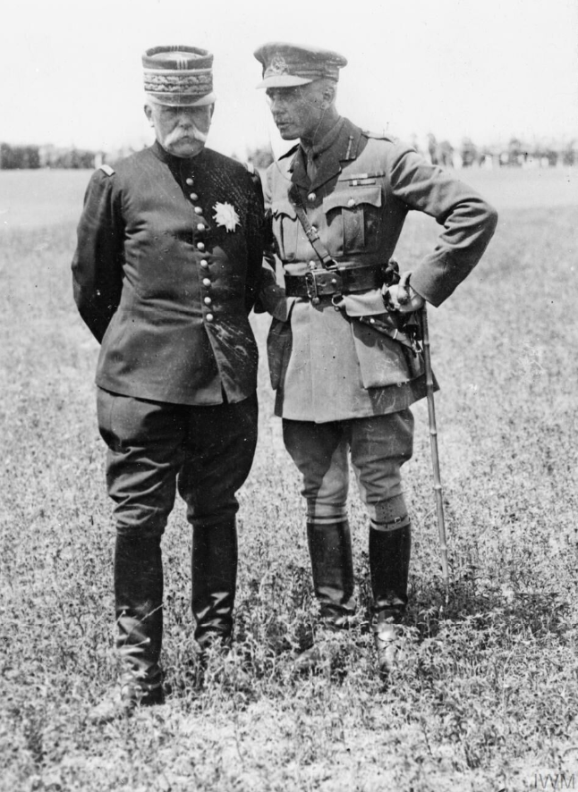
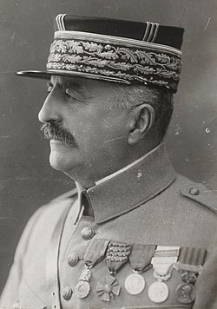
Key Leaders
General Sarrail (France) had overall command in Salonika.
General Sir George Milne commanded British forces.
General Sarrail was later replaced by General Franchet d'Espèrey. The British soldiers called him “Desperate Frankie”!
General Sarrail, commander of Allied forces in Macedonia (16 January 1916 - 22 December 1917), with General Sir George Milne, commander of the British Salonika Force from 9 May 1916.
Notes:
Teacher notes:
Avoid focusing only on famous individuals. Emphasise collective effort and leadership responsibility. Reminder of the international nature of the campaign.

Slide 14
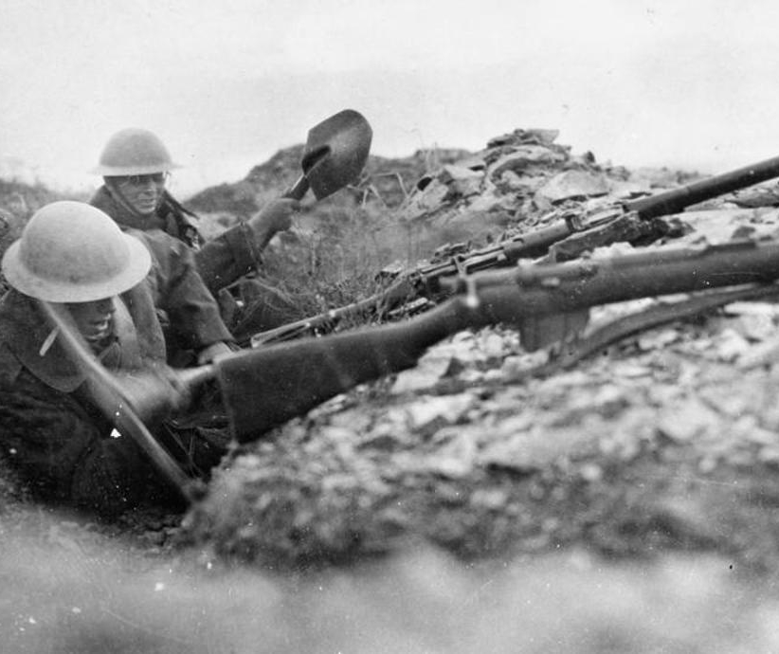
The Final Breakthrough (1918)
In 1918, French and Serbians broke through enemy lines in the west. British troops supported the attack – at great cost of lives - by pinning down Bulgarian troops in the east. Bulgaria soon surrendered.
Notes:
Teacher notes:
Explain that although Britain did not lead the breakthrough, its support mattered. Link Bulgaria’s surrender to the wider collapse of the enemy alliance.

Slide 15
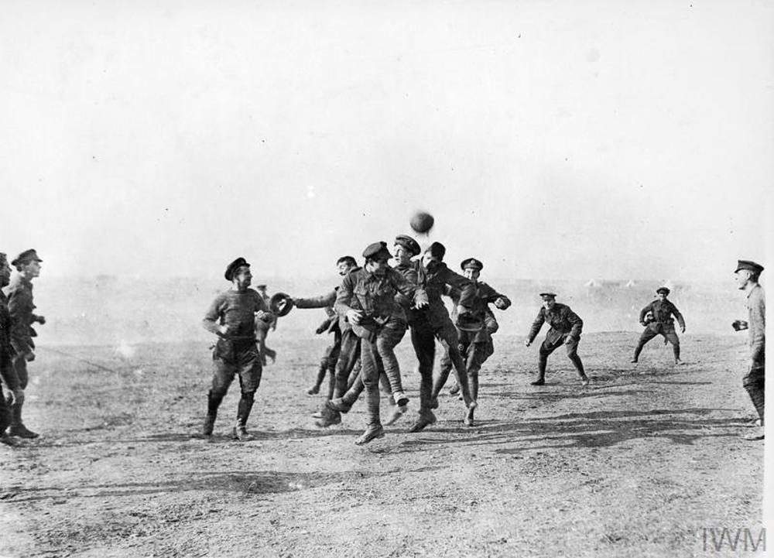
How Britain Viewed the Campaign
Many people in Britain knew little about Salonika. Some called it a “sideshow” and believed soldiers were needed more urgently in France.
Notes:
Teacher notes:
Discuss media influence and public opinion. Ask why some campaigns become better remembered than others.

Slide 16
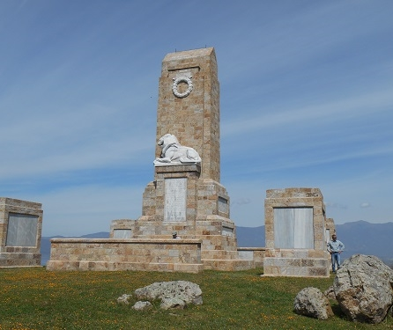
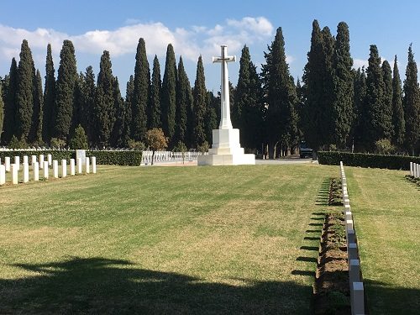
Legacy of the Salonika Campaign
The Salonika Campaign helped weaken the enemy and shorten the war. Today it reminds us that the First World War was fought in many places across the world.
Notes:
Teacher notes:
Conclude by reinforcing the idea of global warfare and remembrance. You may wish to link this to war memorials or local history.

Slide 17
Image Sources
Slide 1 - https://salonikacampaignsociety.org.uk/
Slide 2 - https://collection.nam.ac.uk/detail.php?acc=1978-11-157-29-6
Slide 3 - https://archives.territoiredebelfort.fr/media/fee7d4c4-680b-48b4-ac01-fcd8f4b9f66d.pdf
Slide 5 – https://www.reddit.com/r/imaginarymaps/comments/mtjxm1/no_lore_map_of_the_balkans_before_the_great_war/
Slide 6 - https://collection.nam.ac.uk/detail.php?acc=1978-11-157-11-30
Slide 7 - https://collection.nam.ac.uk/detail.php?acc=1999-10-8-6
Slide 8 - https://www.iwm.org.uk/collections/item/object/205091142 & https://en.wikipedia.org/wiki/Mosquito#/media/File:Aedes_aegypti.jpg
Slide 9 - https://www.cwgc.org/our-work/blog/battles-birdcages-and-boredom-in-the-balkans-the-salonika-campaign/
Slide 10 - https://www.iwm.org.uk/collections/item/object/205217043
Slide 11 - https://www.iwm.org.uk/collections/item/object/205212919 & https://www.iwm.org.uk/collections/item/object/205297517
Slide 12 - https://www.iwm.org.uk/collections/item/object/205380042 & https://www.iwm.org.uk/collections/item/object/205297499
Slide 13 - https://www.iwm.org.uk/collections/item/object/205221850 & https://en.wikipedia.org/wiki/Louis_Franchet_d%27Esp%C3%A8rey
Slide 14 - https://www.cwgc.org/our-work/blog/battles-birdcages-and-boredom-in-the-balkans-the-salonika-campaign/
Slide 15 - https://www.cwgc.org/our-work/blog/battles-birdcages-and-boredom-in-the-balkans-the-salonika-campaign/
Slide 16 - https://salonikacampaignsociety.org.uk/

